Slide 1
Finding Correlations Between Geographical Twitter Sentiment and Stock Prices
Undergraduate Researchers: Juweek Adolphe
Ressi Miranda
Graduate Student Mentor: Zhaoyu Li
Faculty Advisor: Dr. Yi Shang
Notes:
Juweek Adolphe, University of Georgia
Ressi Miranda, Mount Holyoke College
Zhaoyu Li and Dr. Yi Shang, University of Missouri-Columbia

Slide 2
Research Project
Find out whether a specific demographic’s Twitter sentiment has a more significant correlation to a company’s stock price than another

Slide 3
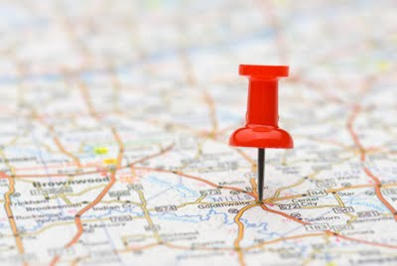
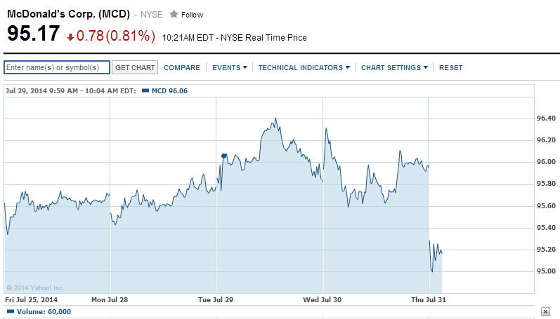
Correlate

Slide 4
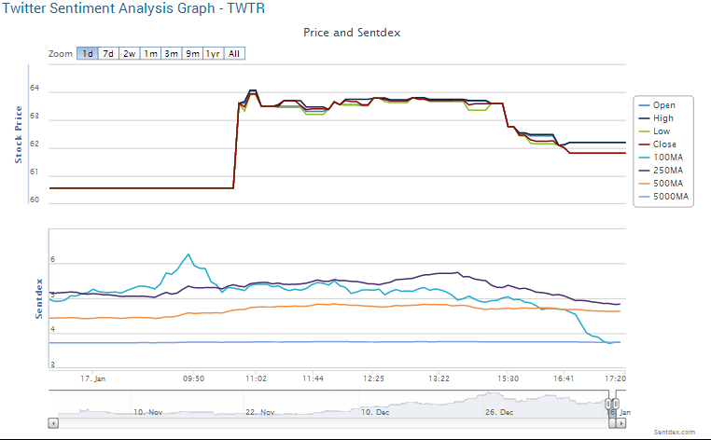
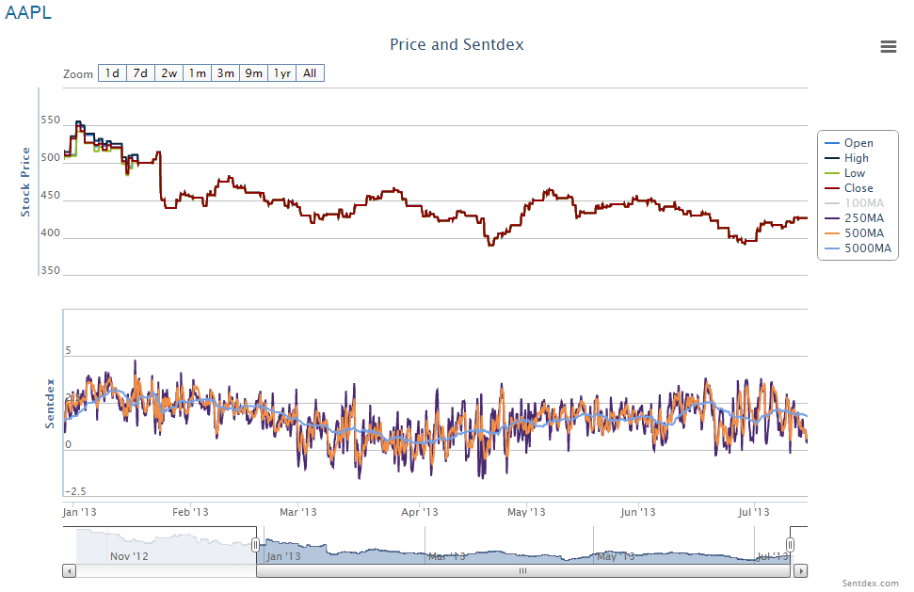
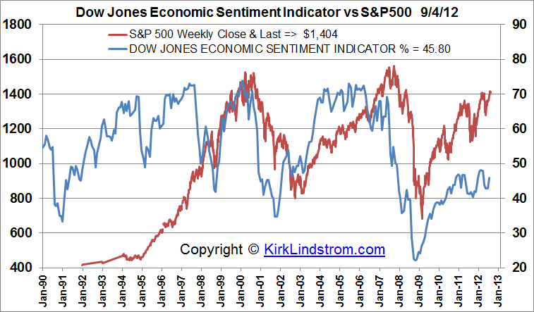
Previous Work
Sources: Sentidex.com

Slide 5
Tools
Sentiment Analysis
Lexicon based approach
finding the sentiment of individual words to get total sentiment of sentence
Tweepy Streaming API
Filtered by topic, language
Matplotlib
Graphs

Slide 6
Methodology: Area
Sector: Food & Restaurants
Standard & Poor’s 500
Companies: McDonalds and Starbucks
Key searches:
Ticket Symbol, Keywords, Company Products
Key Words Sample:
$MCD, Big Mac, McDonalds, Happy Meal
$SBUX, Starbucks, Caramel Macchiato

Slide 7
Making a Dataset
Other dataset didn’t work
Streamed Tweets for 5 days
Filtered by keywords, English
Information Extracted:
company related tweet
time
self-reported location
username
followers count

Slide 8
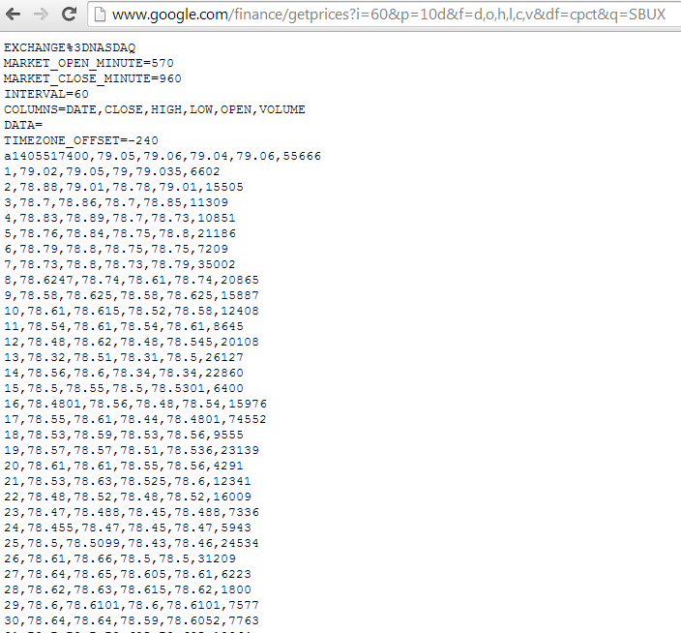
Stock Market Data
Google Finance
Stock Price by the minute

Slide 9
Processing Data
Normalize Tweets
Lowercased
Non-alphanumerical characters (@, $, #, etc.)
Sentiment Analysis
lexicon-based approach
Used SentiWordNet (http://sentiwordnet.isti.cnr.it/)

Slide 10
Lexicon Based Approach Explained
Tweet Example:“going to mcdonald's with mah friends today and i need to
know what toy i should get with my happy meal”
Positive Score | Negative Score | Word: know
0 0 0.125 0 0.125 0 0.25 0.25 0.375 0.625 | 0 0 0 0 0 0 0 0 0 0 | know, recognize, acknowledge know, cognize know know know know, live, experience know know know know
Scores taken from SentiWordNet

Slide 11
Lexicon Based Approach Explained
Tweet Example:“going to mcdonald's with mah friends today and i need to
know what toy i should get with my happy meal”
Positive Score | Negative Score | Word: know
0 0 0.125 0 0.125 0 0.25 0.25 0.375 0.625 Average: 0.1625 | 0 0 0 0 0 0 0 0 0 0 Average: 0 | know, recognize, acknowledge know, cognize know know know know, live, experience know know know know
Scores taken from SentiWordNet

Slide 12
0 0.25 0 0 0 0 0 0 | 0 0 0 0 0 0 0.125 0.125 | toy toy, play, fiddle, diddle toy, play flirt dally toy_dog toy, miniature toy, play thing toy toy
0 0 0 0 0 0 0 0 0 0 0 0.125 0.5 0 0 0 0 0 0 0 0 0.125 0 0 | 0 0 0 0 0 0 0 0 0 0.125 0 0 0 0 0 0 0 0 0 0.125 0 0 0 0 | get get, caused, simulate get, dive, aim get get, fix, pay_back get, catch, capture get, catch get, fetch, convey, bring get, catch, arrest get get, draw get, catch get get_under_ones_skin get, come, arrive get get, get_off get, have, experience get, receive get, catch get, catch get, acquire get, make, have get
Pos | Neg | Word
0 0 | 0 0.5 | going going
0 | 0 | friends
0 0.125 0.25 0 | 0 0 0 0 | today today today, nowadays, now today
0.125 0 0. 0.375 0.125 | 0.125 0.25 0 0.25 0.125 | need, want, require need, involve, demand, postulate need, motive need need, demand
0 0 0.125 0 0.125 0 0.25 0.25 0.375 0.625 | 0 0 0 0 0 0 0 0 0 0 | know, recognize, acknowledge know, cognize know know know know, live, experience know know know know
0.125 0.75 0.875 0.5 | 0 0 0 0 | happy happy happy happy, glad
0 0 0 | 0 0 0 | meal meal, repast meal
Scores taken from SentiWordNet

Slide 13
Positive Average | Negative Average | Word
0.1625 | 0 | going
0 | 0 | friends
0.09375 | 0 | today
0.125 | 0.75 | need
0.175 | 0 | know
0.03125 | 0.03125 | toy
0.03125 | 0.0104166 | get
0.5625 | 0 | happy
0 | 0 | meal
1.18125 | 0.7916666 | Total Sentiment

Slide 14
Tweet Example: “going to mcdonald's with mah friends today and i need to
know what toy i should get with my happy meal”
Positive!

Slide 15
Geographical Location
Filter out by US cities
Choose the top represented cities
assumed self-reported location is valid
Used Google Maps Api to process tweets

Slide 16
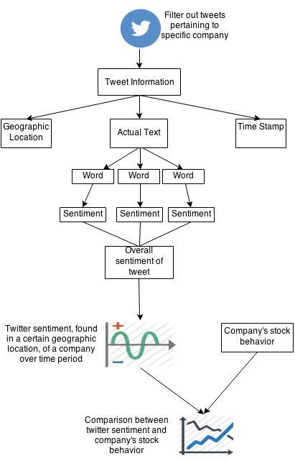
Work Flow

Slide 17
Locations Found
Top Cities (GDP)
New York, NY
Los Angeles, CA
Chicago, IL
Houston, TX
Washington DC
Our Twitter Sample
Cities are highly represented**
Does our Twitter Sample have a high representation of the top cities?
Twitter Top Cities*
New York, NY
Washington DC
Los Angeles, CA
Chicago, IL
Dallas, TX
*Wikipedia.org

Slide 18
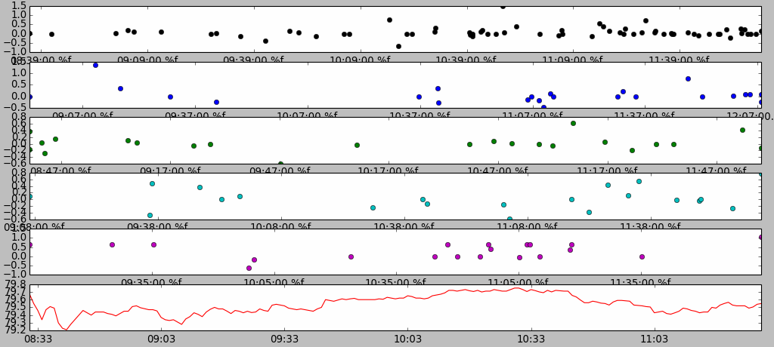
Results

Slide 19
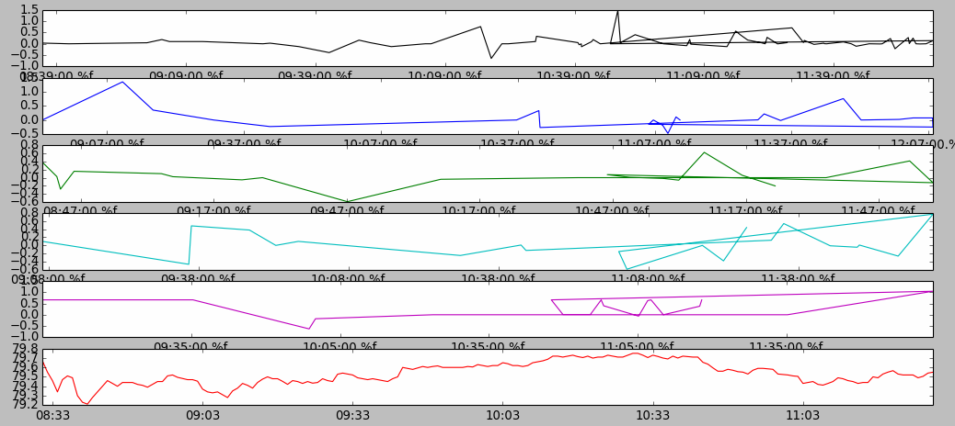
Results

Slide 20
Challenges
Limited time frame
Geographic locations
Different number of tweets/stocks per minute

Slide 21
Future Work
Larger Twitter Sample
Predicting Stock Price
Correlate the number of followers to stock price

Slide 22
References
Cities by GDP
*"List of U.S. Metropolitan Areas by GDP." Wikipedia. Wikimedia Foundation, 22 July 2014. Web. 31 July 2014.
**Mislove, Alan, et al. "Understanding the Demographics of Twitter Users."ICWSM 11 (2011): 5th.

Slide 23
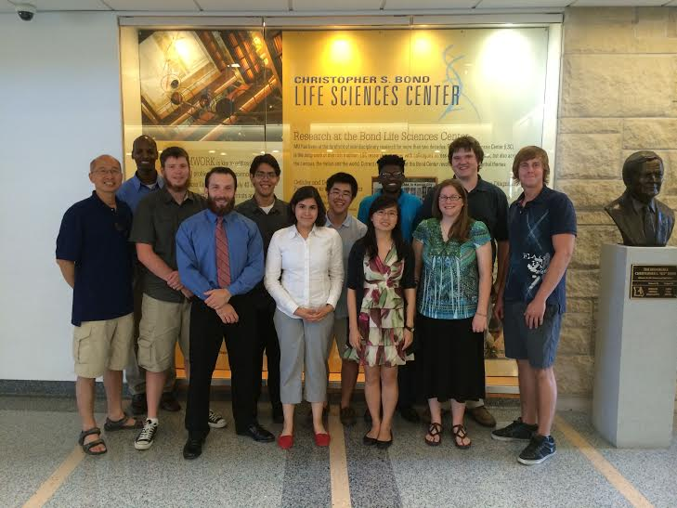
Thank you!
Faculty Advisor: Dr. Shang Yi
Graduate Student: Zhaoyu Li
REU Group & Mentors for their help and support!
University of Missouri
National Science Foundation*
*Award Abstract #1359125
REU: Research in Consumer Networking
Technologies

Slide 24
Questions?

