Slide 1


Improving Remote Access of a Data-Intensive Computing Application: Effects of Encoding and GPU Virtualization
Jerry Adams¹, Bradley Hittle², Eliot Prokop³, Ronny Antequera³, Dr.Prasad Calyam³
University of Hawaii-West Oahu¹, The Ohio State University², University of Missouri-Columbia³

Slide 2
Introduction
Data intensive and High Performance applications are accessed by Remote Desktop (RD)
  Impractical to carry or download large data for computation
Achieving best Quality of Experience (QoE) in RD Applications essential
QoE is an interplay of:
    Quality of Application (QoA)
    Quality of Service (QoS)

Slide 3
3Q Decision Tree Model
Credits: Chris Dopuch, Prasad Calyam
3Q Decision Tree Model uses context awareness through feedback loops by adjusting QoA and QoS to improve the overall user QoE

Slide 4
Overview
Quality of Experience improvement of a RD application that this project explores:
  Encoding scheme selection @ thin-client
  GPU Virtualization scalability @ server
  (Path switching with OpenFlow @ network)

Slide 5
RIVVIR Application (1/2)
Remote Interactive Volume Visualization Infrastructure for Researchers (RIVVIR)
  For Health Care researchers in Small Animal Imaging
  Data intensive volume visualization for MRI viewing
    Typical file size is more than ~0.5 GB
  RD access by remote thin-client to a cloud platform
Used as a case study to test and verify improvements

Slide 6

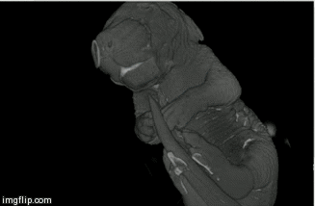
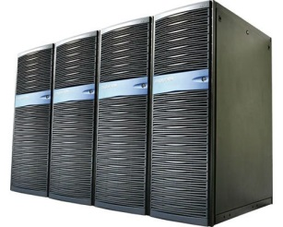

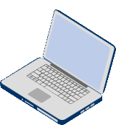
RIVVIR Application (2/2)
MRI Computing Resources @ OSU
Thin client end users @ MU

Slide 7
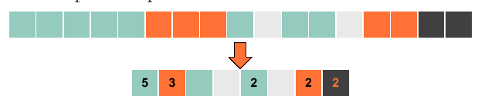
Encoding
VNC (which uses RFB protocol) is used to connect to server
Encoding refers to the encoding of image pixels that are generated by RFB and transported by VNC
Encoding types: Tight, ZRLE, Zlib, ZlibHex, Ultra, Hextile, RRE, Raw, CoRRE, ZYWRLE
Lossless RLE pixel encoding (python.dzone.com)

Slide 8
Encoding Experiment (1/2)
Test 10 available encoding schemes under different network health conditions (affected by network location)
Metrics used in Experiments
  Subjective measurements
    Tournament method is used – variant of a genetic algorithm
    Image responsiveness and image quality using different encoding schemes is compared in a the tournament
  Objective measurements
    Bandwidth Consumption metric is used – amount of bandwidth consumed by protocol measured in megabits per second (Mbps)
    Higher the Bandwidth Consumption, better the image quality

Slide 9
Encoding Experiment (2/2)

Slide 10
Home Wired – Results
Higher the Bandwidth Consumption, better the Image Quality

Slide 11
Home Wireless (Optimal) Results

Slide 12
Home Wireless (Poor) Results

Slide 13
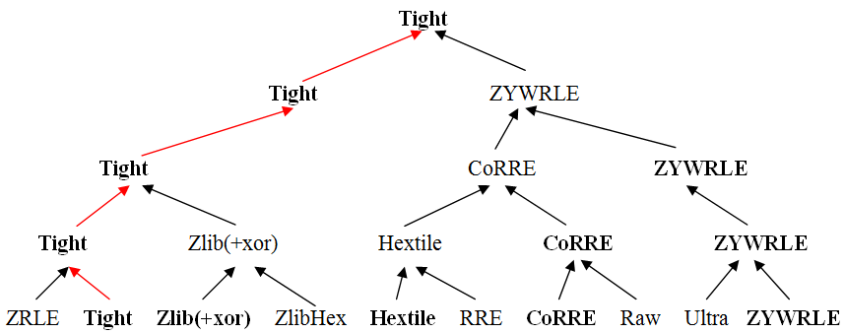
Subjective Tournament Results
For all 3 Network Connections!

Slide 14
Salient Findings
Encoding scheme selection
  Tight performed best subjectively and objectively
  Several encoding schemes performed better than default automatic encoding selected by VNC

Slide 15
Overview
Quality of Experience improvement of a RD application that this project explores:
  Encoding scheme selection @ thin-client
  GPU Virtualization scalability @ server
  (Path switching with OpenFlow @ network)

Slide 16
GPU Virtualization (1/2)
Virtualization of a physical GPU to support use by multiple virtual desktops
  Application and user feel as if they own an entire physical GPU
3D X Server acts as a hypervisor and translates all graphics calls using VirtualGL
  Multiple users on RIVVIR are emulated by creating multiple virtual X displays, connecting them from different remote machines
  Display assignment and load balancing: Spread out instances across different GPUs using vglrun -d :0.x command

Slide 17
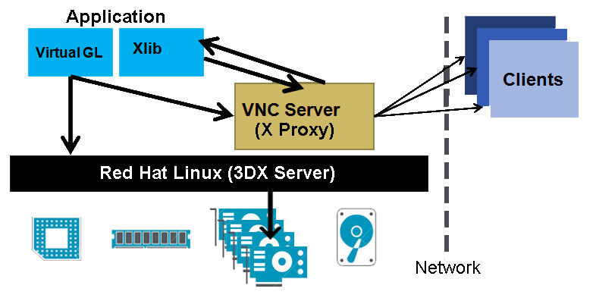
GPU Virtualization (2/2)
For details: http://svn.code.sf.net/p/virtualgl/code/trunk/doc/x11transport.png

Slide 18
GPU Virtualization Experiment
5 client devices
  Asus G50V Laptop (Laptop 1)
  Asus U36SD Laptop (Laptop 2)
  MacBook Pro Laptop (Laptop 3)
  iPad (Tablet)
  Samsung Galaxy S4 (Smartphone)
Dataset
  Rotating Molerat fetus ~ 150Mb
Objective measurement: Avg. GPU Utilization % measured every second for 15 seconds

Slide 19
Objective Results (1/2)
Dataset: Molerat Fetus (~150Mb)
Network: MizzouWireless

Slide 20
Objective Results (2/2)
Dataset: Molerat Fetus (~150Mb)
Network: MizzouWireless

Slide 21
Salient Findings
GPU Virtualization scalability
  RIVVIR handles up to five clients simultaneously without loss of QoE
  Certain clients seem to consume less GPU resources than others

Slide 22
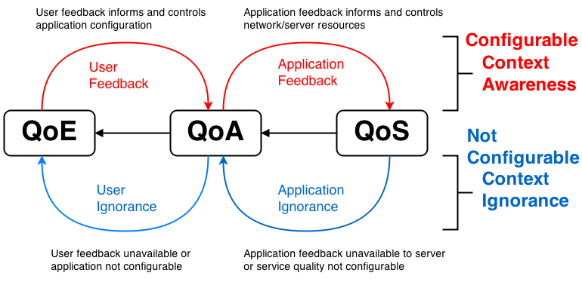
Study Significance
Our results provide:
  Insights for RIVVIR enhancements to deliver satisfactory volume visualization user experience for remote users
    Particularly, high number of users accessing from diverse networks
  Preliminary data to fully validate the 3Q Model

Slide 23
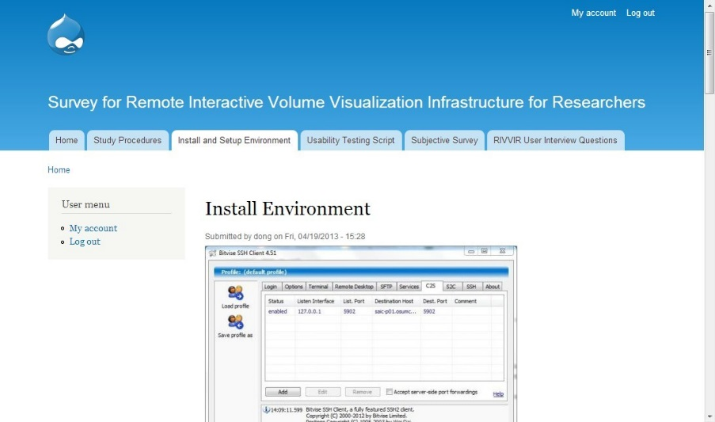
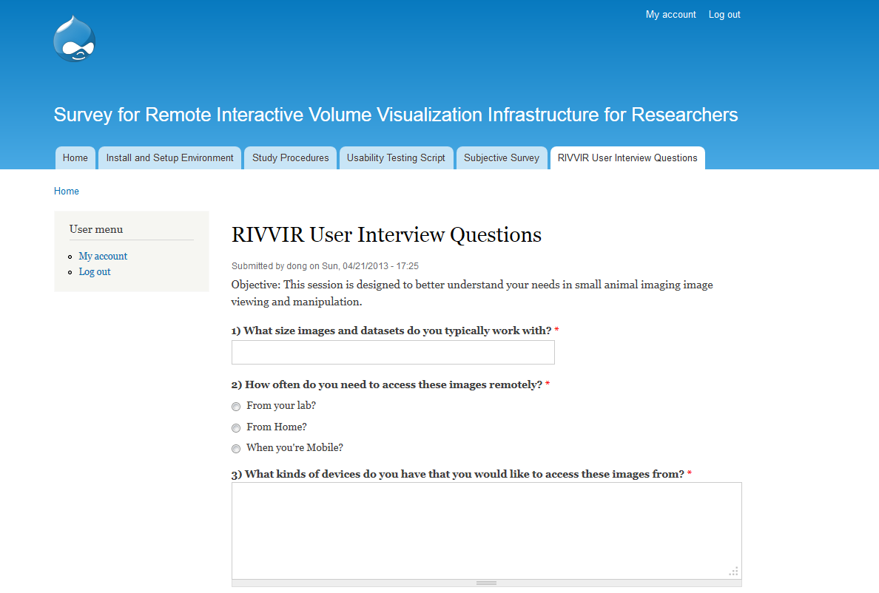
Future Work (1/3)
Subjective testing with Encoding scheme selection
  Data collection with human participants and Mean Opinion Scores (MOS)
    Planning data collection close to server (@ Ohio State U.); we expect the tournament model will present different results

Slide 24
Future Work (2/3)
  More testing regarding amount of clients system can support
    Planning data collection to determine how scale of user connections can impact encoding selection of connected clients
    Automate the data collection with testing scripts so that experiments can be repeated more easily and analyzed quickly

Slide 25
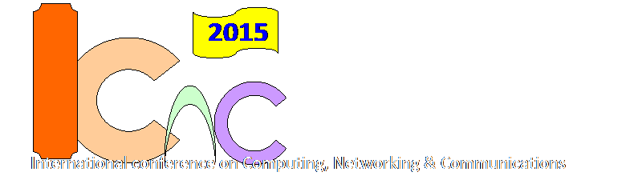
Future Work (3/3)
  More testing to determine if different client devices consume different amounts of GPU resources
    Planning data collection to determine whether “hybrid” computing can be effective, where thin-client is also rich in computational resources
      iPad4 as a thin-client still has a dual-core 1.4GHz processor!
  Paper being prepared for submission
    2014 IEEE International Conference on Computing, Networking and Communication, Disneyland!
  Finish the Path switching experiments of RIVVIR with OpenFlow @ network… ☺

Slide 26
References
[1] T. Richardson, Q. Stafford-Fraser, K. R. Wood, and A. Hopper. (1998). “Virtual Network Computing.” IEEE Internet Computing, 2, 33-38.
[2] Vlado Menkovski, Adetola Oredope, Antonio Liotta, and Antonio Cuadra Sanchez, 2009. “Predicting Quality of Experience in Multimedia Streaming.” In proceedings of the 7th International Conference on Advances in Mobile Computing and Multimedia (MoMM ’09). ACM, New York, NY, USA, 52-59.
[3] T. Richardson. “The Remove Frame Buffer (RFB) Protocol.” <http://www.realvnc.com/docs/rfbproto.pdf>. 2010.
[4] K. Kaplinsky. “VNC Tight Encoder-data Compression for VNC.” Proc. of Scientific and Practical Conference of Students, Post-graduates and Young Scientists, 2001.
[5] P. Deutsch and J-L. Gailly. “ZLIB Compressed Data Format Specification.” IETF RFC 1950. <http://www.zlib.net>. 1996.
[6] W. Jiang, H. Jin, and et. al. “A Novel Remote Screen Synchronization Mechanism for Ubiquitous Environments.” Symposium of Pervasive Computing and Applications, 2006.
[7] P. Calyam, A. Kalash, A. Krishnamurthy, G. Renkes. “A Human-and-Network Aware Encoding Adaptation Scheme for Remote Desktop Access.” IEEE Workshop on Multimedia Signal Processing (MMSP), 2009.

Slide 27

Thank you for your attention!
Any questions?
This material is based upon work supported by National Science Foundation under award numbers CNS-1205658 and CNS-1359125. Any opinions, findings, and conclusions or recommendations expressed in this publication are those of the author(s) and do not necessarily reflect the views of National Science Foundation.

