Slide 1
An Evolutionary Method for Training Autoencoders for Deep Learning Networks
Master’s Thesis Defense
Sean Lander
Advisor: Yi Shang

Slide 2
Agenda
Overview
Background and Related Work
Methods
Performance and Testing
Results
Conclusion and Future Work

Slide 3
Agenda
Overview
Background and Related Work
Methods
Performance and Testing
Results
Conclusion and Future Work

Slide 4
Overview
Deep Learning classification/reconstruction
Since 2006, Deep Learning Networks (DLNs) have changed the landscape of classification problems
Strong ability to create and utilize abstract features
Easily lends itself to GPU and distributed systems
Does not require labeled data – VERY IMPORTANT
Can be used for feature reduction and classification

Slide 5
Overview
Problem and proposed solution
Problems with DLNs:
  Costly to train with large data sets or high feature spaces
  Local minima systemic with Artificial Neural Networks
  Hyper-parameters must be hand selected
Proposed Solutions:
  Evolutionary based approach with local search phase
    Increased chance of global minimum
    Optimizes structure based on abstracted features
  Data partitions based on population size (large data only)
    Reduced training time
    Reduced chances of overfitting

Slide 6
Agenda
Overview
Background and Related Work
Methods
Performance and Testing
Results
Conclusion and Future Work

Slide 7
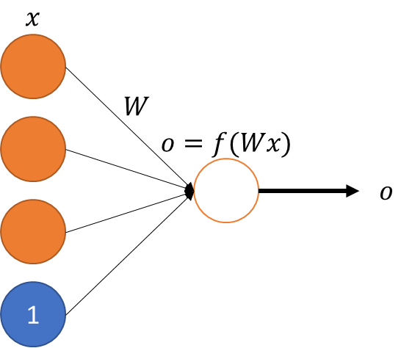
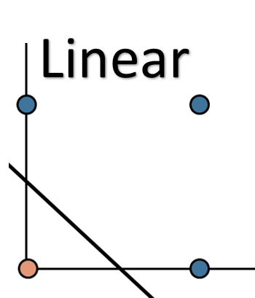
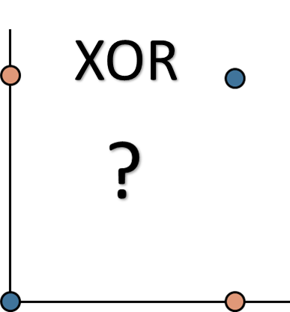
Background
Perceptrons
Started with Perceptron in 1950
Only capable of linear separability
Failed on XOR

Slide 8
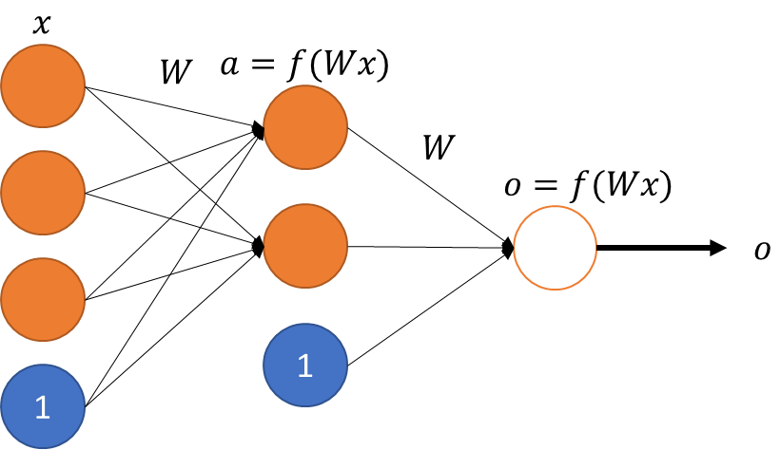
Background
Artificial Neural Networks (ANNs)
ANNs went out of favor until the Multilayer Perceptron (MLP) introduced
Pro: Non-linear classification
Con: Time consuming
Advance in training: Backpropagation
Increased training speeds
Limited to shallow networks
Error propagation diminishes a
number of layers increase

Slide 9
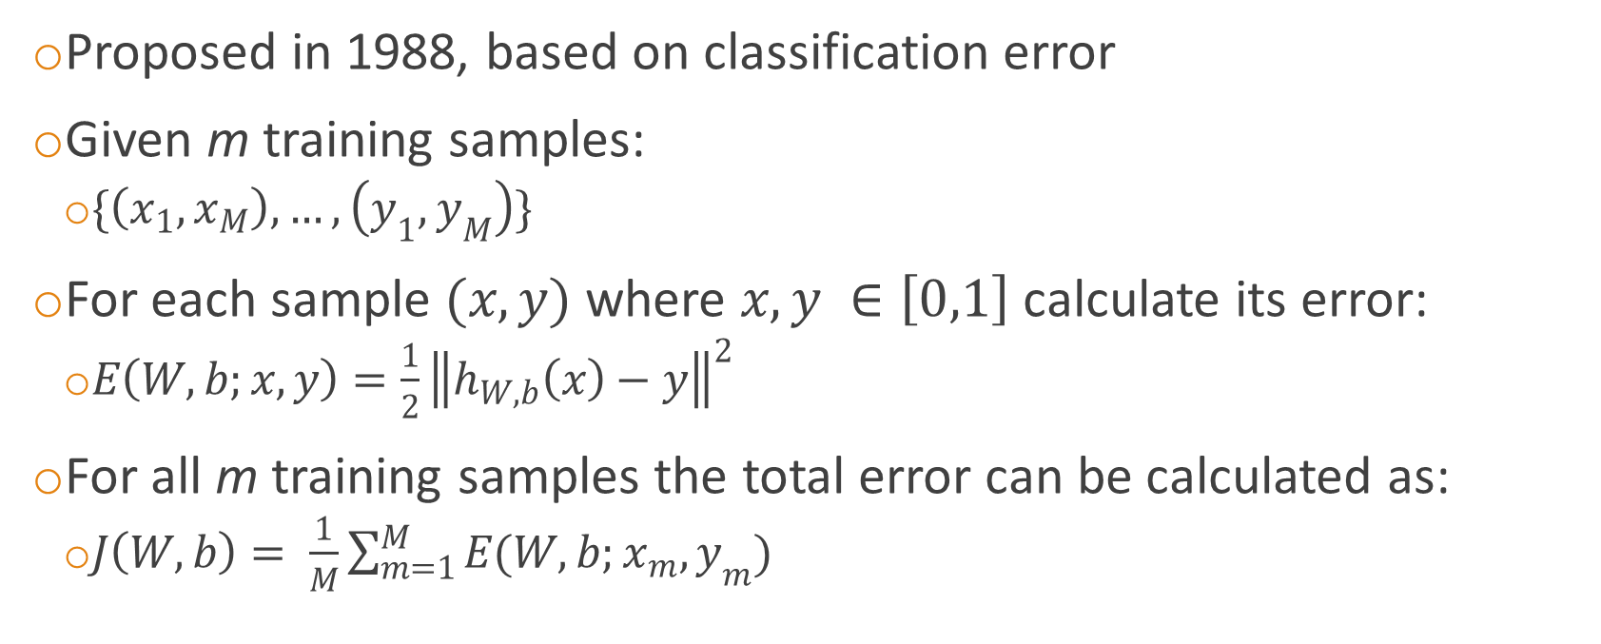
Background
Backpropagation using Gradient Descent
Proposed in 1988, based on classification error
Given m training samples:
  $\{\left(x_{1},x_{M}\right),…,\left(y_{1},y_{M}\right)\}$
For each sample $(x,y)$ where $x,y ∈\left[0,1\right]$ calculate its error:
  $E\left(W,b;x,y\right)=\frac{1}{2}{\left\|h_{W,b}\left(x\right)−y\right\|}^{2}$
For all m training samples the total error can be calculated as:
  $J\left(W,b\right)= \frac{1}{M}\sum_{m=1}^{M}{E(W,b;x_{m},y_{m})}$

Slide 10
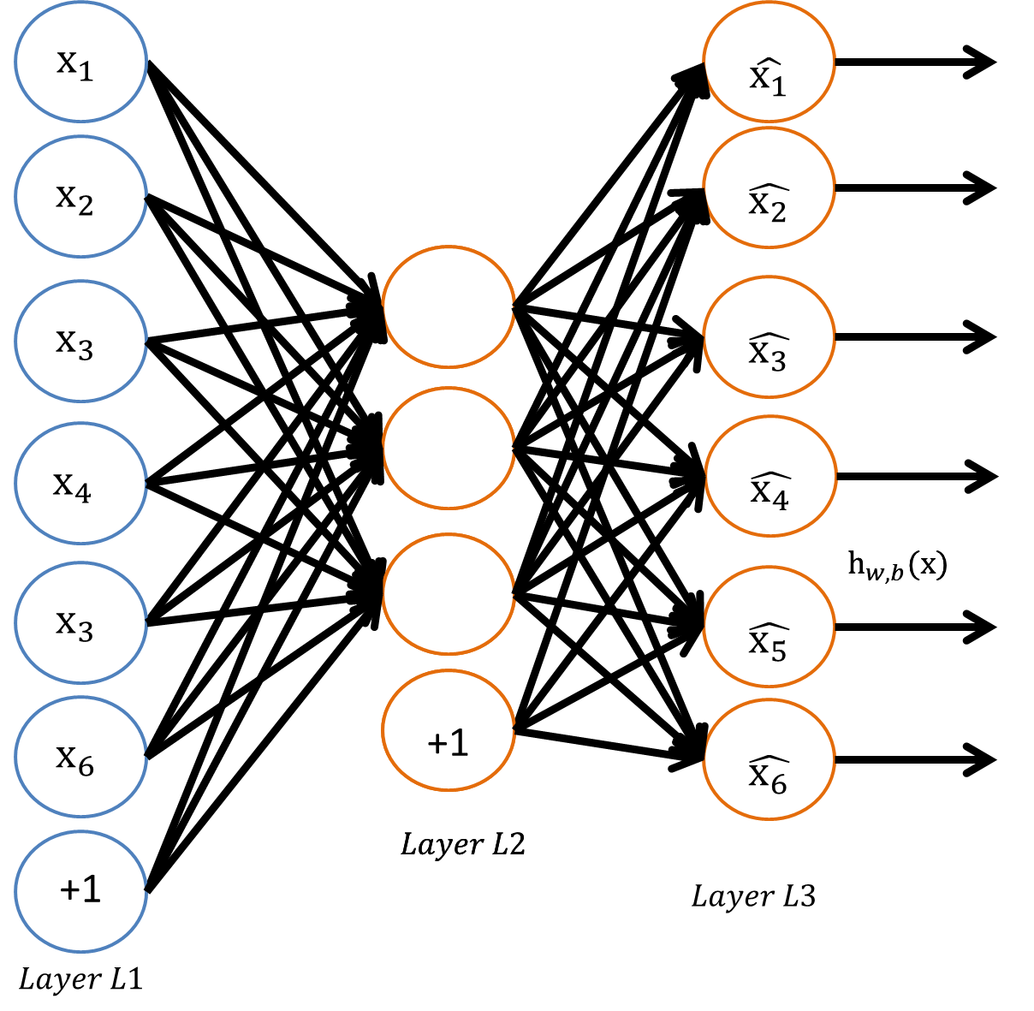
Background
Deep Learning Networks (DLNs)
Allows for deep networks with multiple layers
Layers pre-trained using unlabeled data
Layers are “stacked” and fine tuned
Minimizes error degradation for deep
neural networks (many layers)
Still costly to train
Manual selection of hyper-parameters
Local, not global, minimum

Slide 11
Background
Autoencoders for reconstruction
Autoencoders can be used for
feature reduction and clustering
“Classification error” is the ability
to reconstruct the sample input
Abstracted features – output from
the hidden layer – can be used to
replace raw input for other
techniques

Slide 12
Related Work
Evolutionary and genetic ANNs
First use of Genetic Algorithms (GAs) in 1989
  Two layer ANN on a small data set
  Tested multiple types of chromosomal encodings and mutation types
Late 1990s and early 2000s introduced other techniques
  Multi-level mutations and mutation priority
  Addition of local search in each generation
  Inclusion of hyper-parameters as part of the mutation
  Issue of competing conventions starts to appear
    Two ANNs produce the same results by sharing the same nodes but in a permuted order

Slide 13
Related Work
Hyper-parameter selection for DLNs
Majority of the work explored using newer technologies and methods such as GPU and distributed (MapReduce) training
Improved versions of Backpropagation, such as Conjugated Gradient or Limited Memory BFGS were tested under different conditions
Most conclusions pointed toward manual parameter selection via trial-and-error

Slide 14
Agenda
Overview
Background and Related Work
Methods
Performance and Testing
Results
Conclusion and Future Work

Slide 15
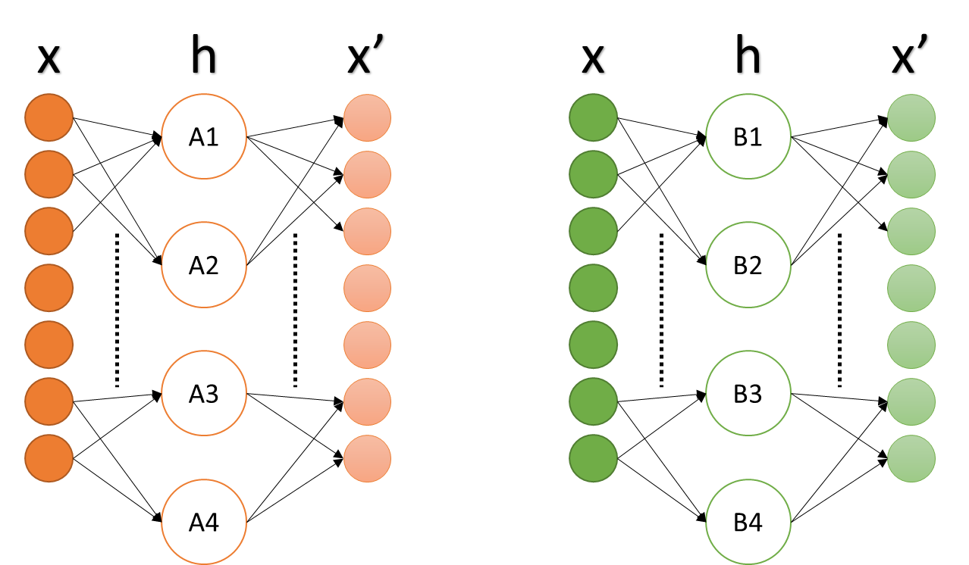
Method 1
Evolutionary Autoencoder (EvoAE)
IDEA: Autoencoders’ power are in their feature abstraction, the hidden node output
Training many AEs will
make more potential
abstracted features
Best AEs will contain the
best features
Joining these features
should create a better AE

Slide 16
Method 1
Evolutionary Autoencoder (EvoAE)
A population of autoencoders (AEs) is initialized with a semi-random number of hidden nodes
Each AE is trained for a small number
of epochs using Backpropagation
The AEs are ranked based on
reconstruction error
The top AEs are selected for crossover
New AEs are mutated based on mutation
rate, with an even chance at gaining or
losing a node
New nodes are selected randomly from
the population, not randomly initialized
Continue until convergence criteria is met

Slide 17
Method 1
Evolutionary Autoencoder (EvoAE)
x
h
x’
x
h
x’
A1
B1
A2
B2
Local Search
Initialization
Crossover
Mutation
A3
B3
A4
C2

Slide 18
Method 1A
Distributed learning and Mini-batches
Training of generic EvoAE increases in time linearly to the size of the population
ANN training time increases drastically with data size
To combat this, mini-batches can be used where each AE is trained against a batch and updated
  Batch size << total data

Slide 19
Method 1A
Distributed learning and Mini-batches
EvoAE lends itself to distributed system
Data duplication and storage now an issue due to data duplication
Batch 1
Train
  Forward propagation
  Backpropagation
Batch 2
Rank
  Calculate error
  Sort
…
GA
  Crossover
  Mutate
Batch N

Slide 20
Method 2
EvoAE Evo-batches
IDEA: When data is large, small batches can be representative
Prevents overfitting as nodes being trained are almost always introduced to new data
Scales well with large amounts of data even when parallel training is not possible
Works well on limited memory systems by increasing size of the population, thus reducing data per batch
Quick training of large populations, equivalent to training a single autoencoder using traditional methods

Slide 21
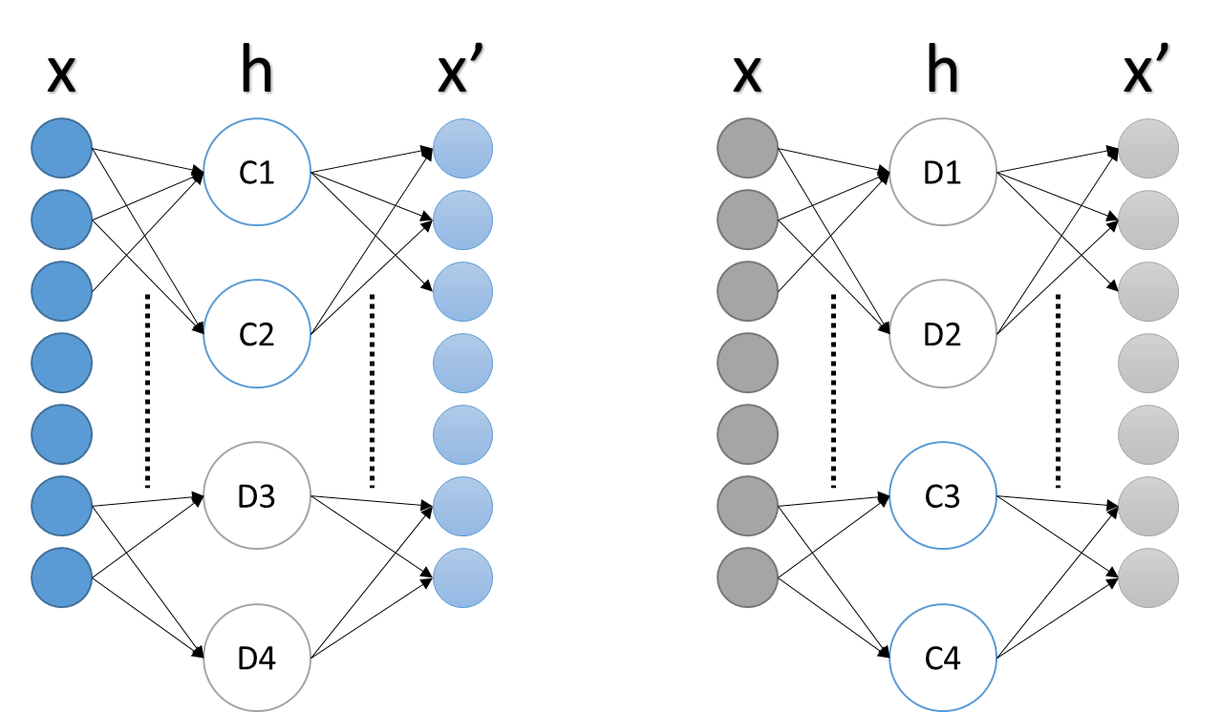
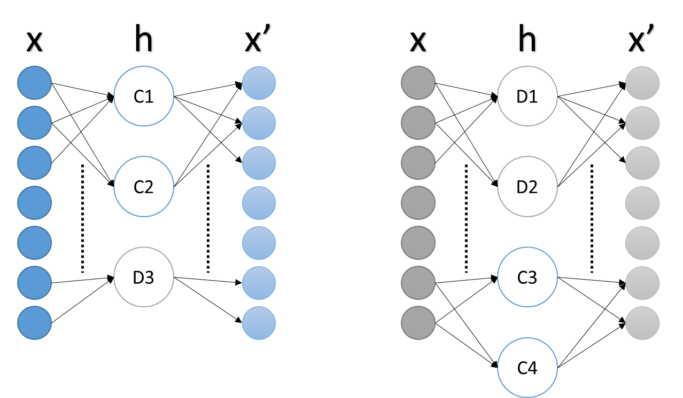
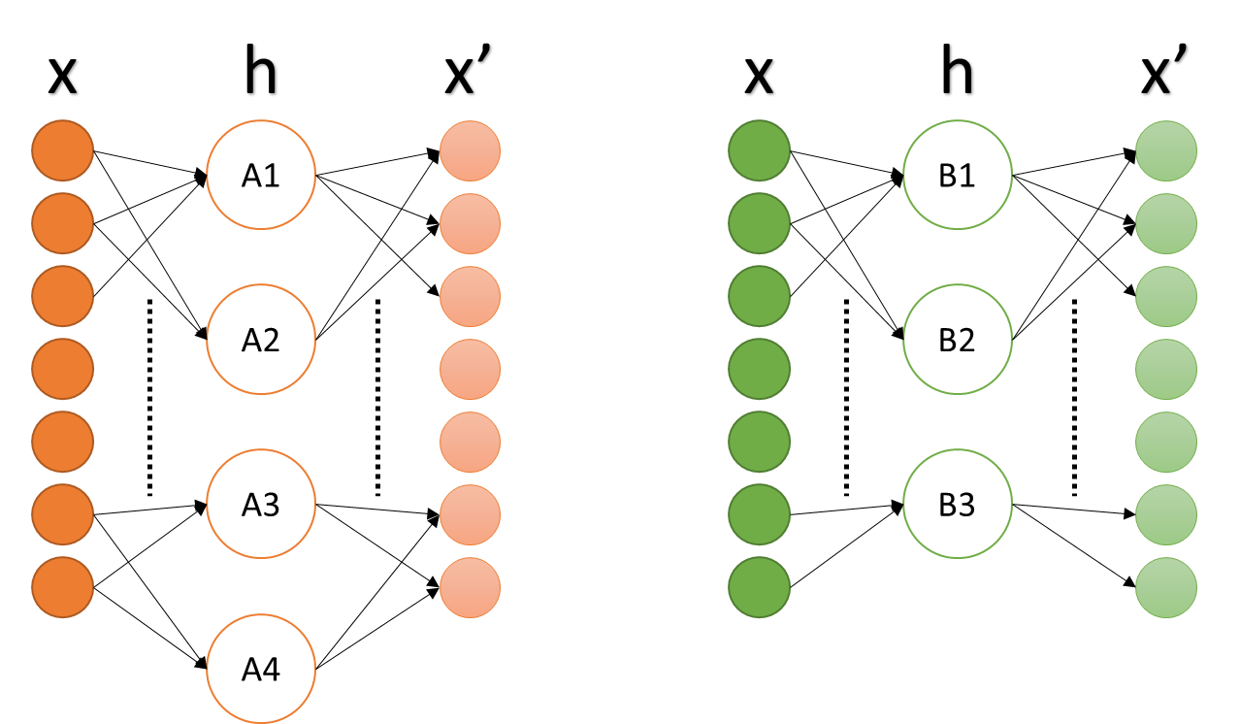
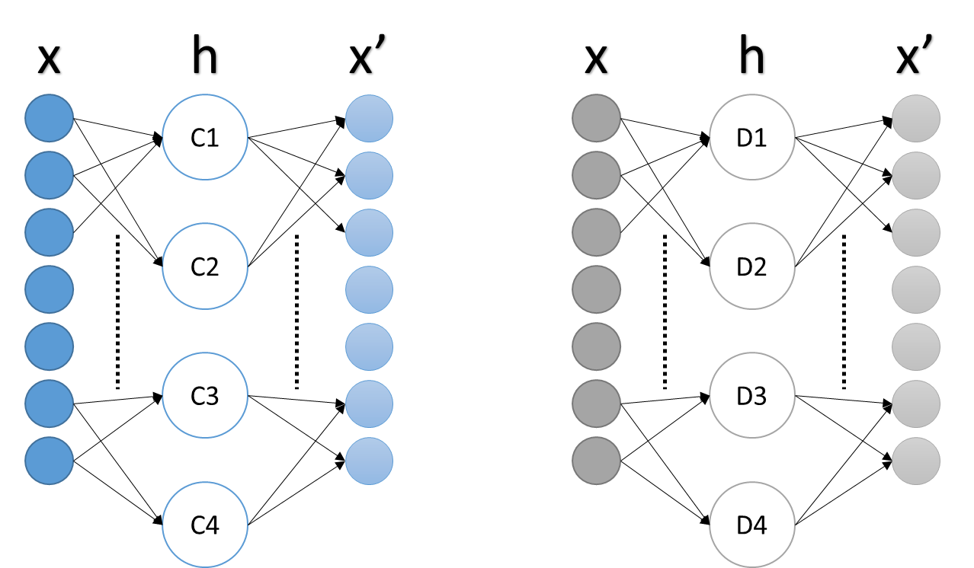
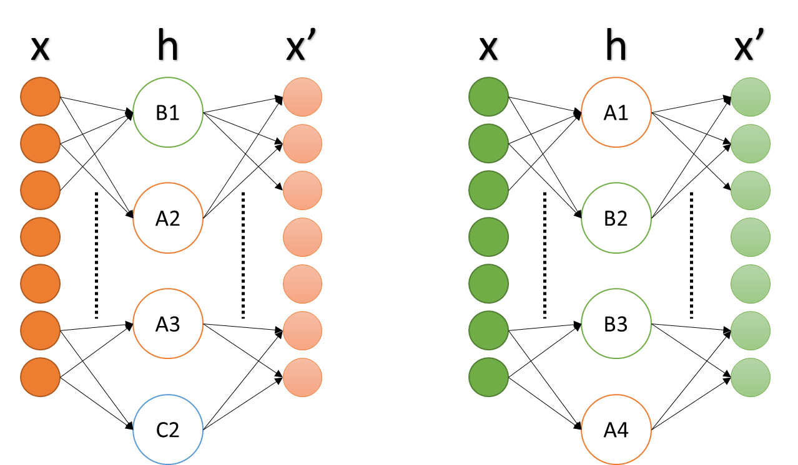
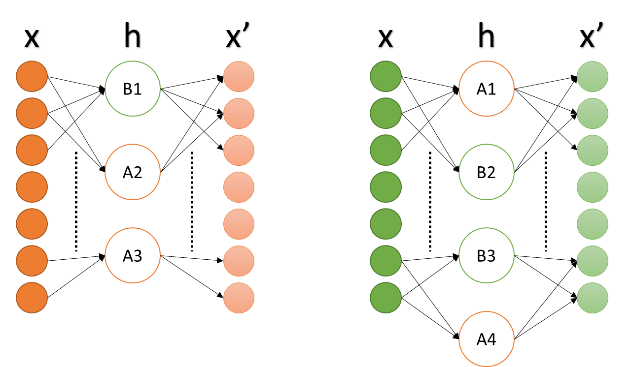
Method 2
EvoAE Evo-batches
Original Data
Data A
Data B
Data A
Data B
Data C
Data D
Data C
Data D
Local Search
Crossover
Mutate

Slide 22
Agenda
Overview
Background and Related Work
Methods
Performance and Testing
Results
Conclusion and Future Work

Slide 23
Performance and Testing
Hardware and testing parameters
Lenovo Y500 laptop
  Intel i7 3rd generation 2.4GHz
  12 GB RAM
All weights randomly initialized to N(0,0.5)
Parameter | Defaults
Learning Rate | 0.1
Momentum | 2
Weight Decay | 0.003
Population Size | 30
Generations | 50
Epochs/Gen | 20
Train/Validate | 80/20
Parameter | Wine | Iris | Heart Disease | MNIST
Hidden Size | 32 | 32 | 12 | 200
Hidden Std Dev | NULL | NULL | NULL | 80
Hidden +/- | 16 | 16 | 6 | NULL
Mutation Rate | 0.1 | 0.1 | 0.1 | 0.1

Slide 24
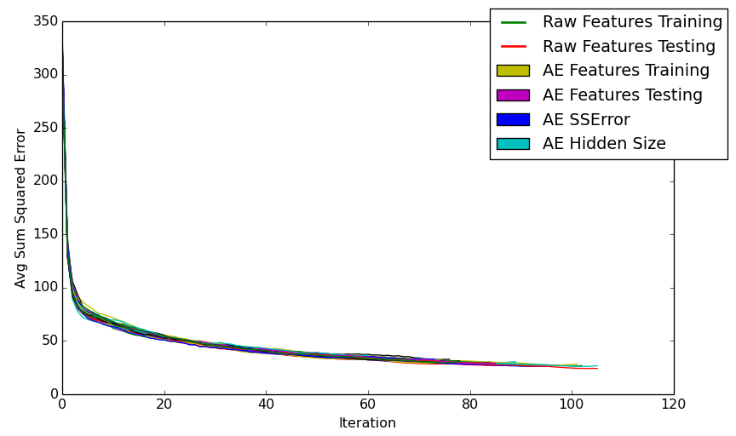
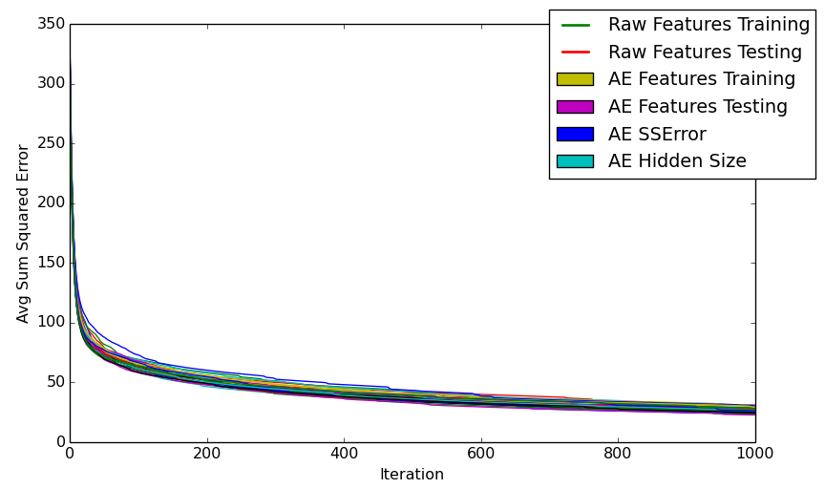
Performance and Testing
Baseline
Baseline is a single AE with 30 random initializations
Two learning rates to create two baseline measurements
  Base learning rate
  Learning rate * 0.1
Learning rate
Learning rate * 0.1

Slide 25
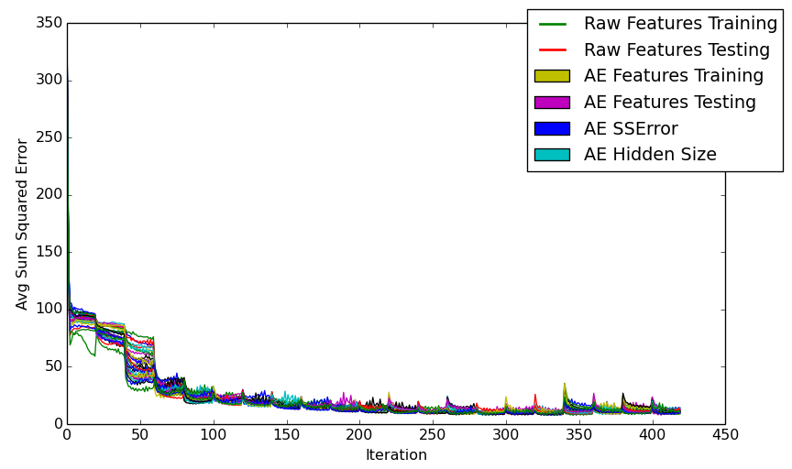
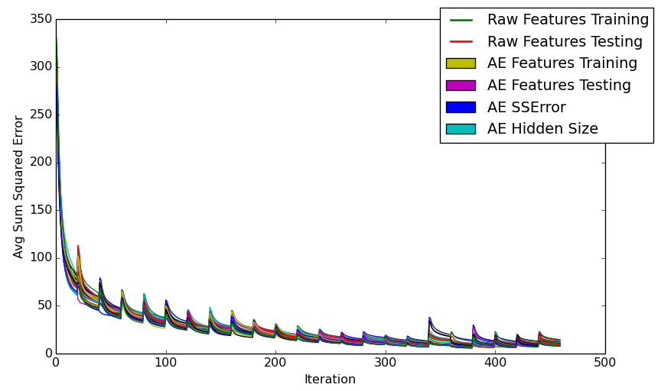
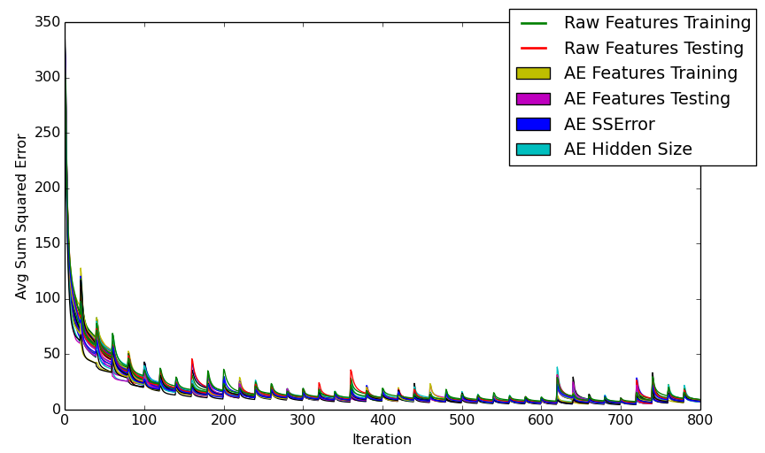
Performance and Testing
Data partitioning
Three data partitioning methods were used
  Full data
  Mini-batch
  Evo-batch
Full data
Mini-batch
Evo-batch

Slide 26
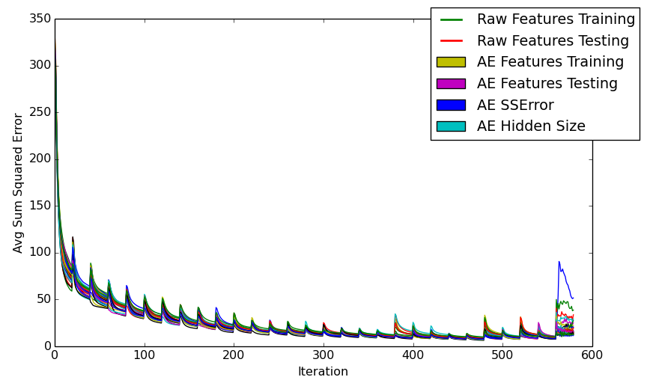
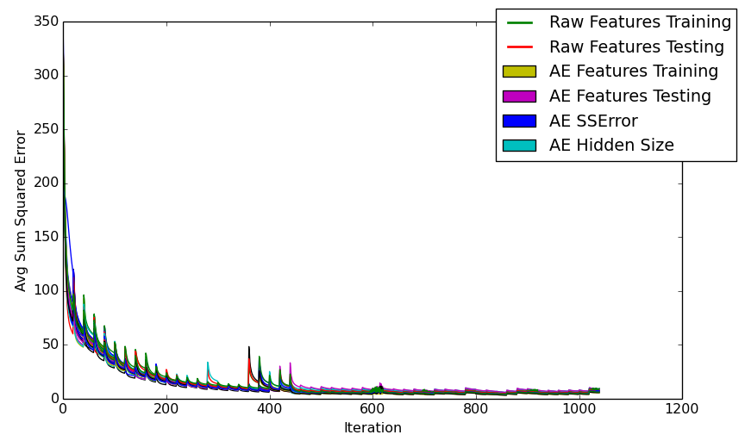
Performance and Testing
Post-training configurations
Post-training run in the following ways
  Full data (All)
  Batch data (Batch)
  None
All sets below are using the Evo-batch configuration
Full data
Batch data
None

Slide 27
Agenda
Overview
Background and Related Work
Methods
Performance and Testing
Results
Conclusion and Future Work

Slide 28
Results
Parameters Review
Parameter | Wine | MNIST
Hidden Size | 32 | 200
Hidden Std Dev | NULL | 80
Hidden +/- | 16 | NULL
Mutation Rate | 0.1 | 0.1
Parameter | Defaults
Learning Rate | 0.1
Momentum | 2
Weight Decay | 0.003
Population Size | 30
Generations | 50
Epochs/Gen | 20
Train/Validate | 80/20

Slide 29
Results
Datasets
UCI wine dataset
  178 samples
  13 features
  3 classes
Reduced MNIST dataset
  6000/1000 and 24k/6k training/testing samples
  784 features
  10 classes (0-9)

Slide 30
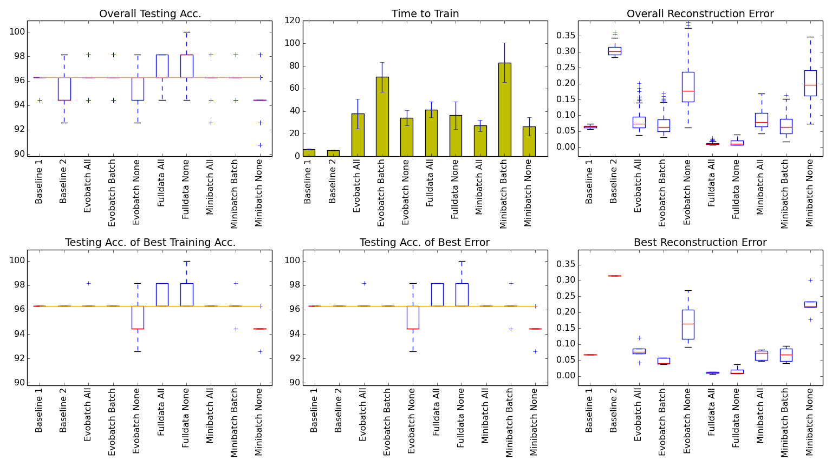
Results
Small datasets - UCI Wine
Parameter | Wine
Hidden Size | 32
Hidden Std Dev | NULL
Hidden +/- | 16
Mutation Rate | 0.1

Slide 31
Results
Small datasets - UCI Wine
Parameter | Wine
Hidden Size | 32
Hidden Std Dev | NULL
Hidden +/- | 16
Mutation Rate | 0.1
Best error-to-speed:
  Baseline 1
Best overall error:
  Full data All
Full data is fast on
small scale data
Evo- and mini-batch
not good on small
scale data

Slide 32
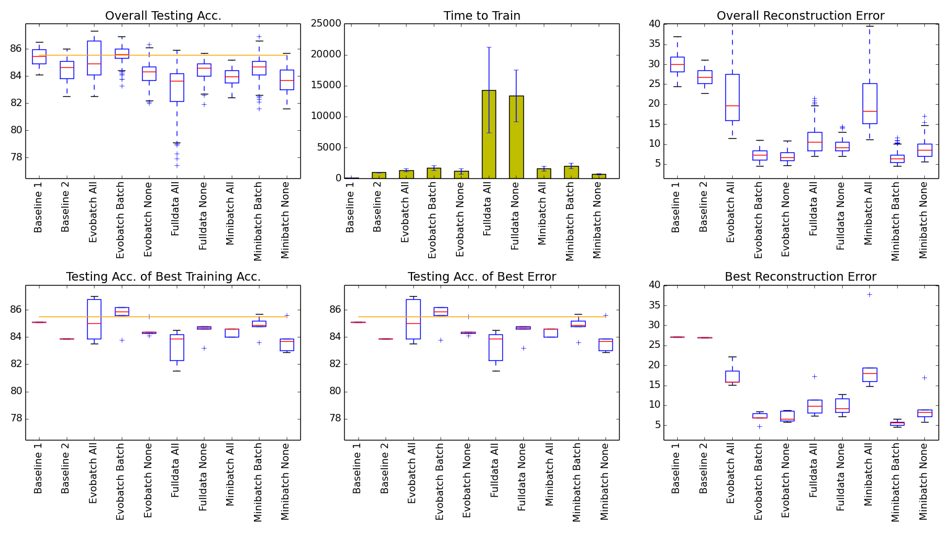
Results
Small datasets – MNIST 6k/1k
Parameter | MNIST
Hidden Size | 200
Hidden Std Dev | 80
Hidden +/- | NULL
Mutation Rate | 0.1

Slide 33
Results
Small datasets – MNIST 6k/1k
Parameter | MNIST
Hidden Size | 200
Hidden Std Dev | 80
Hidden +/- | NULL
Mutation Rate | 0.1
Best error-to-time:
  Mini-batch None
Best overall error:
  Mini-batch Batch
Full data slows
exponentially on
large scale data
Evo- and mini-batch
close to baseline speed

Slide 34
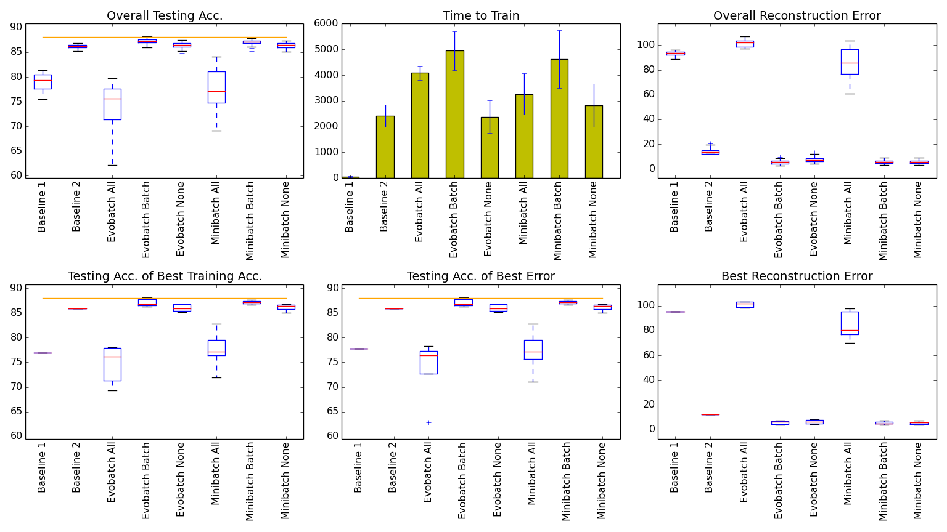
Results
Medium datasets – MNIST 24k/6k
Parameter | MNIST
Hidden Size | 200
Hidden Std Dev | 80
Hidden +/- | NULL
Mutation Rate | 0.1

Slide 35
Results
Medium datasets – MNIST 24k/6k
Parameter | MNIST
Hidden Size | 200
Hidden Std Dev | 80
Hidden +/- | NULL
Mutation Rate | 0.1
Best error-to-time:
  Evo-batch None
Best overall error:
  Evo-batch Batch OR
  Mini-batch Batch
Full data too slow to
run on dataset
EvoAE w/ population
30 trains as quickly as
a single baseline AE
when using Evo-batch

Slide 36
Agenda
Overview
Background and Related Work
Methods
Performance and Testing
Results
Conclusion and Future Work

Slide 37
Conclusions
Good for large problems
Traditional methods are still preferred choice for small problems and toy problems
EvoAE with Evo-batch produces effective and efficient feature reduction given a large volume of data
EvoAE is robust against poorly-chosen hyper-parameters, specifically learning rate

Slide 38
Future Work
Immediate goals:
  Transition to distributed system, MapReduce based or otherwise
  Harness GPU technology for increased speeds (~50% in some cases)
Long term goals:
  Open the system for use by novices and non-programmers
  Make the system easy to use and transparent to the user for both modification and training purposes

Slide 39
Thank you

Slide 40
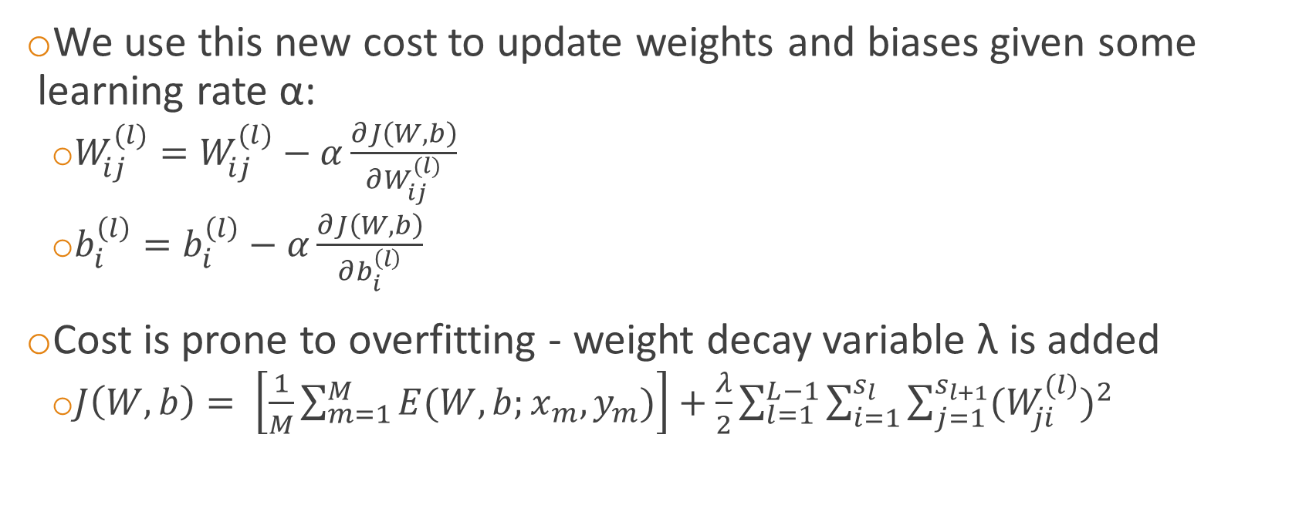
Background
Backpropagation with weight decay
We use this new cost to update weights and biases given some learning rate α:
  $W_{ij}^{(l)}=W_{ij}^{(l)}−α\frac{∂J\left(W,b\right)}{∂W_{ij}^{(l)}}$
  $b_{i}^{\left(l\right)}=b_{i}^{\left(l\right)}−α\frac{∂J\left(W,b\right)}{∂b_{i}^{\left(l\right)}}$
Cost is prone to overfitting - weight decay variable λ is added
  $J\left(W,b\right)= \left[\frac{1}{M}\sum_{m=1}^{M}{E(W,b;x_{m},y_{m})}\right]+\frac{λ}{2}\sum_{l=1}^{L−1}{\sum_{i=1}^{s_{l}}{\sum_{j=1}^{s_{l+1}}{{(W_{ji}^{(l)})}^{2}}}}$

Slide 41
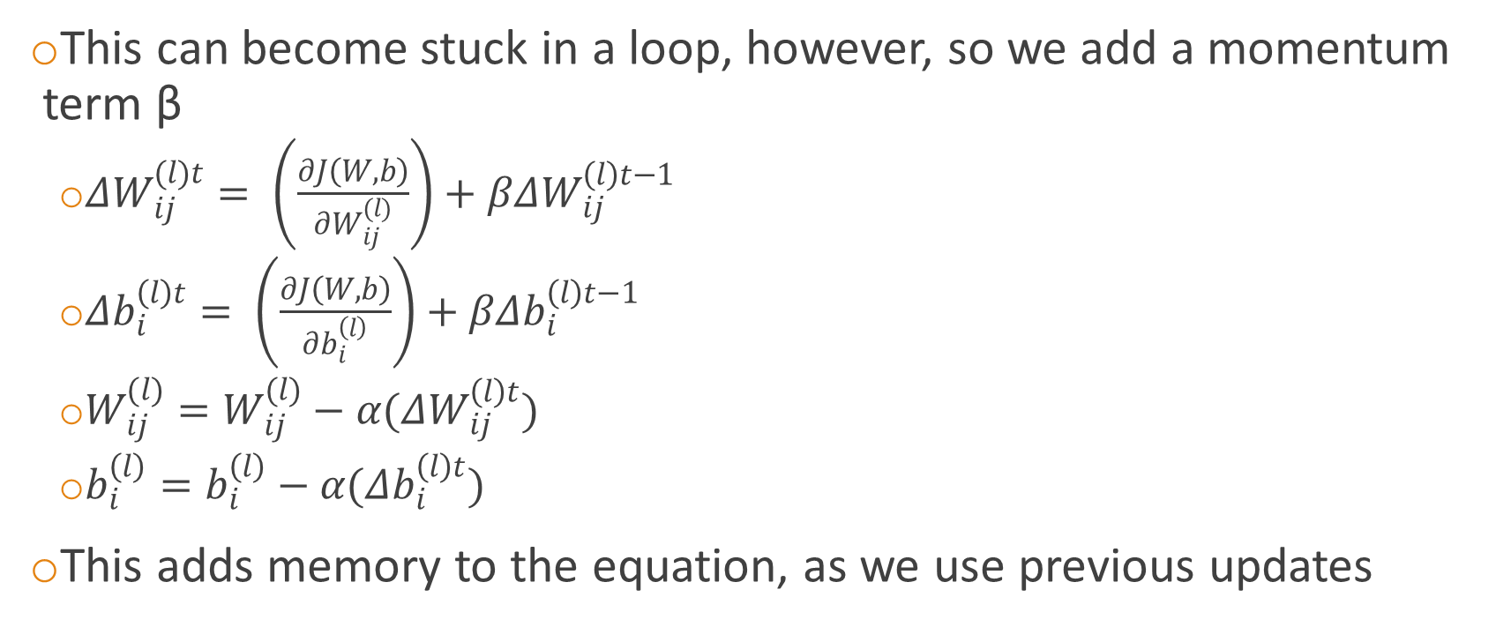
Background
Conjugated Gradient Descent
This can become stuck in a loop, however, so we add a momentum term β
  $ΔW_{ij}^{(l)t}= \left(\frac{∂J\left(W,b\right)}{∂W_{ij}^{(l)}}\right)+βΔW_{ij}^{\left(l\right)t−1}$
  $Δb_{i}^{\left(l\right)t}= \left(\frac{∂J\left(W,b\right)}{∂b_{i}^{\left(l\right)}}\right)+βΔb_{i}^{\left(l\right)t−1}$
  $W_{ij}^{(l)}=W_{ij}^{(l)}−α(ΔW_{ij}^{\left(l\right)t})$
  $b_{i}^{\left(l\right)}=b_{i}^{\left(l\right)}−α(Δb_{i}^{\left(l\right)t})$
This adds memory to the equation, as we use previous updates

Slide 42
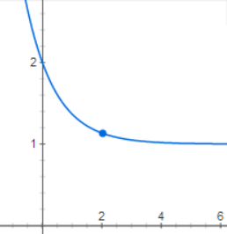
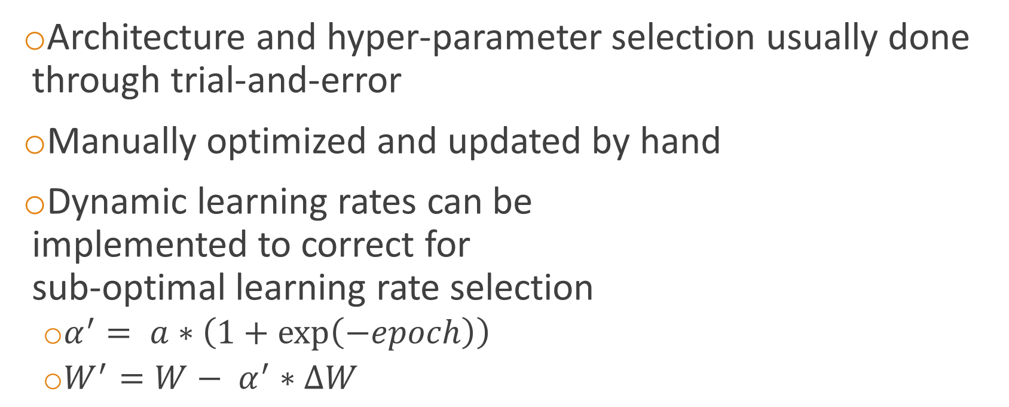
Background
Architecture and hyper-parameters
Architecture and hyper-parameter selection usually done through trial-and-error
Manually optimized and updated by hand
Dynamic learning rates can be
implemented to correct for
sub-optimal learning rate selection
  $α^{′}= a∗\left(1+\exp\left(−epoch\right)\right)$
  $W^{′}=W− α^{′}∗∆W$

Slide 43
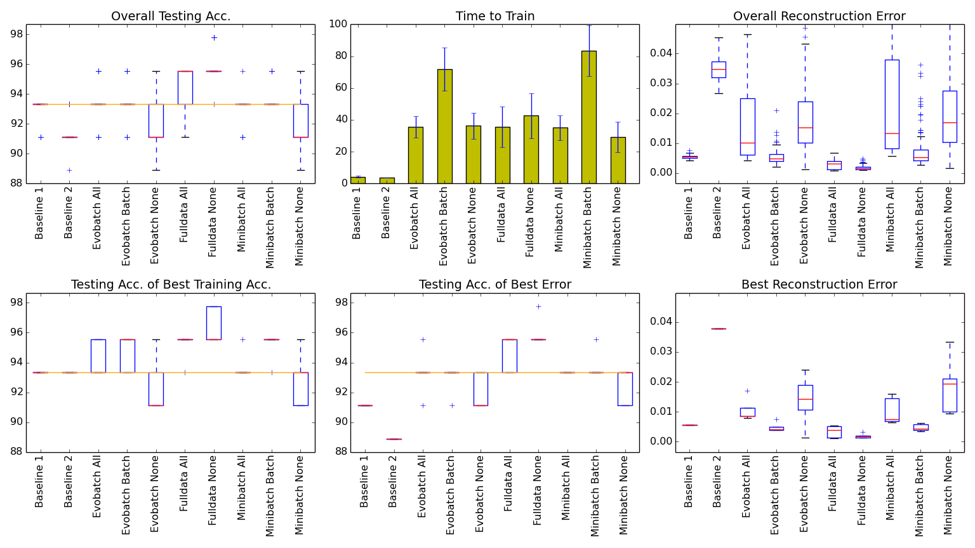
Results
Small datasets – UCI Iris
Parameter | Iris
Hidden Size | 32
Hidden Std Dev | NULL
Hidden +/- | 16
Mutation Rate | 0.1
The UCI Iris dataset has 150 samples with 4 features and 3 classes
Best error-to-speed:
  Baseline 1
Best overall error:
  Full data None

Slide 44
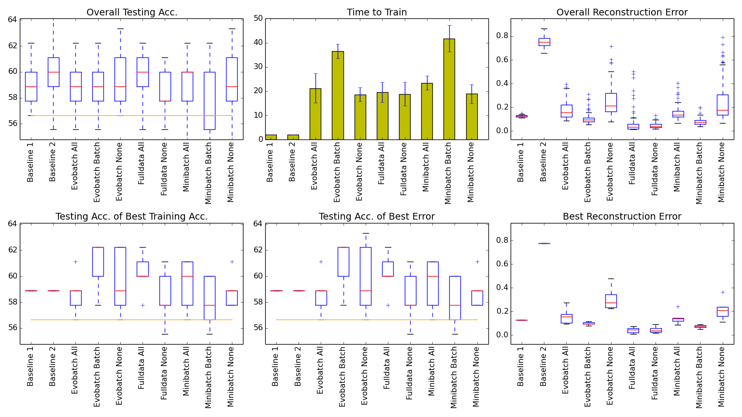
Results
Small datasets – UCI Heart Disease
Parameter | Heart Disease
Hidden Size | 12
Hidden Std Dev | NULL
Hidden +/- | 6
Mutation Rate | 0.1
The UCI Heart Disease dataset has 297 samples with 13 features and 5 classes
Best error-to-time:
  Baseline 1
Best overall error:
  Full data None

