Slide 1
Multi-Layered Interfaces in Mobile Technologies:
2 versus 3 Layers
Dr. Skubic
Moein Enayati
Brian On
Alice Wong
Chandler Mendenhall
Notes:
brian

Slide 2
Roadmap of Presentation
Project Overview
Multi-Layered Interfaces
Related work
Research Question
Implementation
Demo
Study
Results
Timeline and Goals

Slide 3
Project Overview
Mobile health applications have the potential to improve the lives of older adults
Problem: Elderly tend to experience more difficulties learning to use mobile phones + applications
Notes:
Old people and technology, Why we want to implement this study
Brian

Slide 4
One Solution: Multi-Layered Interfaces
Separate application into multiple layers of increasing complexity and functionality
Start user on most simplified, base layer
Transition user to increasingly complex layers
Notes:
Brian

Slide 5
Related Work
“Multi-Layered Interfaces to Improve Older Adults’ Initial Learnability of Mobile Applications” -September 2010
“Which chart or graph is right for you?”
Notes:
Brian

Slide 6
“Multi-Layered Interfaces to Improve Older Adults’ Initial Learnability of Mobile Applications”
Multi-Layered interfaces helped participants master basic tasks on a mobile address book application
Multi-Layered interfaces helped participants retain learned skills
Notes:
Brian

Slide 7
Research Question
Extends aforementioned paper’s research
What is more efficacious -- 2 or 3 layers of functional division?
Hypothesis: 3 layers helps older adults learn to use mobile technologies more because it parses the application into manageable chunks
Notes:
Why we chose our mobile application
Chandler

Slide 8
Implementation: Step 1
Design mobile, web-based application
Has four charts/graphs that displays different health-related data
Time in bed
Pulse rate
Frequency of bathroom visits
Motion hits
Notes:
Chandler

Slide 9
Demo
Notes:
Describe the graphs, the data and where it comes from?
Alice

Slide 10
Why Application that Delivers Health Report?
If application is too simple, creating a three-layer version of it would be redundant
Wanted experimental application to resemble complexity/functionality of existing applications for elderly
results more applicable to real world
Notes:
alice

Slide 11
Implementation: Step 2
Create two versions of application
2 Layer Version of Application
3 Layer Version of Application
Notes:
Alice

Slide 12
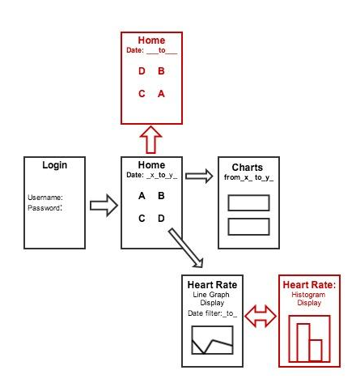
Two Layer Division of App
Extra Features:
Switch between graph types to view same data
Tooltip for x, y coordinates of selected data point
Notification on homepage of data updates
Customizability of home page
Simultaneous display of different chart types for given data
Zoom-in capabilities
Min/max data point search
Notes:
Alice

Slide 13
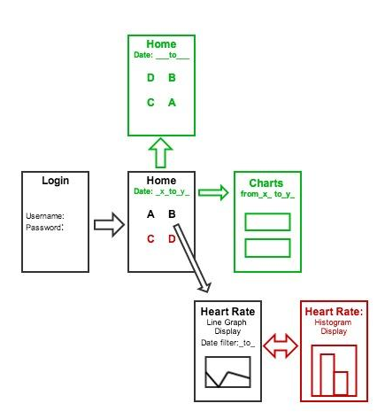
Three Layer Division of App
Extra Features:
Tooltip for x, y coordinates of selected data point
Notification on homepage of data updates
Switch between graph types to view same data
Simultaneous display of different chart types for given data
Customizability of home page
Zoom-in capabilities
Min/max data point search
Notes:
Alice

Slide 14
Study
Plan to perform a study at TigerPlace using 14 to 25 residents
Randomly assign participants to one of two groups
One group uses two-layer version
Other group uses three-layer version
Ask each group to complete tasks
Notes:
Chandler

Slide 15
Results
Objective data: the time it takes to complete specified tasks given and amount of (extra) steps taken
Subjective data: rating how they felt about completing the task, the application and what improvements they would like to see
Notes:
Chandler

Slide 16
Timeline and Goals
Divide application into layers & style (July 7)
Create survey/design study (July 7)
Become IRB certified (July 9)
Perform study & survey subjects (July 11)
Analyze data & write paper (July 31)
Notes:
Alice

Slide 17
Questions?

