Slide 1
Final Presentation
Investigating the effectiveness of EVC and PCC as community-centered centrality measures
Undergraduate Researchers:
Graduate Student Mentor:
Faculty Mentor:
Jordan Cowart, Katie Allmeroth
Krist Culmer
Dr. Wenjun Zeng

Slide 2
Outline
Personal Experiences
Project Overview
Implementations
Scripts
Gephi
Web Crawler
EVC / PCC
Results
Data Analysis
Conclusion
Accomplishments
Future Work

Slide 3
Outline
Personal Experiences
Project Overview
Implementations
Scripts
Gephi
Web Crawler
EVC / PCC
Results
Data Analysis
Conclusion
Accomplishments
Future Work

Slide 4
Personal Experiences
Learned:
Python
Built a web crawler
Social Networks
Centrality measures
Social Capital
Graph Visualization software; Gephi and SNAP
Extend functionality of open source software (PCC Plugin)
Research process
Related research

Slide 5
Outline
Personal Experiences
Project Overview
Implementations
Scripts
Gephi
Web Crawler
EVC / PCC
Results
Data Analysis
Conclusion
Accomplishments
Future Work

Slide 6
Project Overview
Which node is more important, A or B?

Slide 7
Project Overview
Which node is more important, A or B?
Node A:
Current centrality measures would say this node is more important because it has a large number of connections.
But what about Node B?
It’s connections are more diverse; indicating it has a higher value of social capital

Slide 8
Project Overview
Goal of project:
Investigate if/how current centrality measures take community membership into account and if necessary develop a centrality measure that considers community membership
Why is this important:
It will allow us to have a better understanding of who the most important individuals are in a network

Slide 9
Two measures of centrality
Eigenvector Centrality (EVC)
Principal Component Centrality (PCC)
Ilyas, M.U.; Radha, H. "Identifying Influential Nodes in Online Social Networks Using Principal Component Centrality", Communications (ICC), 2011 IEEE International Conference on, On page 6.

Slide 10
Project Overview
1. Develop a web crawler to extract user data from the Mizzou Facebook graph, including ground-truth user-defined communities
2. Apply Eigenvector Centrality (EVC) and Principal Component Centrality (PCC) to collected and provided data sets to characterize properties of the algorithms
3. Develop analysis tools as needed
4. Develop a centrality measure that takes community membership and resource availability into consideration

Slide 11
Outline
Personal Experiences
Project Overview
Implementations
Scripts
Gephi
Web Crawler
EVC / PCC
Results
Data Analysis
Conclusion
Accomplishments
Future Work

Slide 12
Scripts
Wrote a ton of scripts to aid us with our work
Wrote scripts to:
Clean data
Extract information from a text and convert to a .graph file
To visualize SNAP data in Gephi
Color graph
To compile information to make pie charts (shown later)

Slide 13
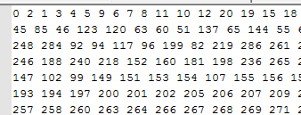
Gephi
Visualization and exploration platform for networks
Understanding data like below.. is hard.

Slide 14
Easier, right?

Slide 15
Web Crawler
Built a web crawler in Python to gather publicly available Facebook Data
Faster to deploy and more flexible than Facebook’s API
Collects only information from Mizzou declared students
Accomplishes this by using a targeted, breadth-first search

Slide 16
Web Crawler
Collected the following data:
Major, gender, home town, Mizzou friends, Mizzou related likes
Majors are condensed into colleges (e.g. Computer Science -> College of Engineering)
Likes are condensed into general community resources (e.g. GPC, MSA, GSA -> Student Governance)

Slide 17
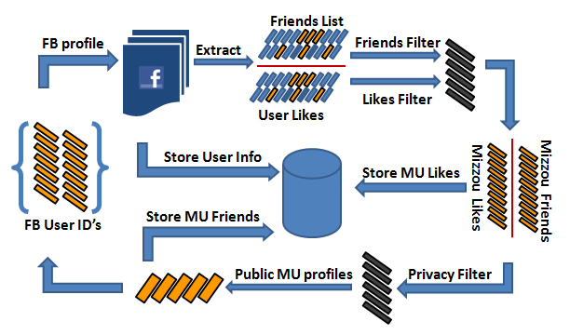
Web Crawler

Slide 18
Web Crawler
Problems encountered:
Facebook’s HTML/CSS (Inconsistent format)
BeautifulSoup’s Speed and Parsing
Logging in + staying logged in
Gathering entire Friends/Like list
Complete error handling (URLLib / Regex Errors)
Facebook probation

Slide 19
EVC / PCC
Used the EVC implementation found in the Stanford Network Analysis Platform (SNAP) and in Gephi
Developed a PCC analysis tool using functions made available in the SNAP C++ Library
Problems encountered:
Poor documentation
Typedef’s for everything

Slide 20
Outline
Personal Experiences
Project Overview
Implementations
Scripts
Gephi
Web Crawler
EVC / PCC
Results
Data Analysis
Conclusion
Accomplishments
Future Work

Slide 21
Data Analysis

Slide 22
Data Analysis - EVC

Slide 23
Data Analysis - PCC

Slide 24
Data Analysis
Looked at friendship demographics for the top 20%
Education majors tend to cluster with themselves
Graduates brag about credentials more than undergrads
Kris plans to look at portion of friends for undergraduate vs. graduates and see how their demographics compare

Slide 25
Outline
Personal Experiences
Project Overview
Implementations
Scripts
Gephi
Web Crawler
EVC / PCC
Results
Data Analysis
Conclusion
Accomplishments
Future Work

Slide 26
Conclusion
Based on analysis from open source data sets, it appears that a centrality measure that explicitly takes community membership into account is needed to determine the criticality of a node or nodes in a social network
We developed a framework of principles for the new centrality measure
Resilience against isolation due to edge severance
Number of Inter/Extra-community connections
Value of community membership
Ability to direct resources to (influence) other nodes

Slide 27
Outline
Personal Experiences
Project Overview
Implementations
Scripts
Gephi
Web Crawler
EVC / PCC
Results
Data Analysis
Conclusion
Accomplishments
Future Work

Slide 28
Accomplishments
Starting a research project from scratch
Learned Python
Built a web crawler
Learned to work with open source frameworks
Survived REU experience

Slide 29
Outline
Personal Experiences
Project Overview
Implementations
Scripts
Gephi
Web Crawler
EVC / PCC
Results
Data Analysis
Conclusion
Accomplishments
Future Work

Slide 30
Future Work
Collect more data from Mizzou Facebook
Improve the web crawler
Implement Parallel crawls
Make available for other researchers
Refine our definition of social capital as needed
Research on other social networks
Twitter, LinkedIn, etc.
Using the previously mentioned principles, develop a new centrality method

Slide 31
Thank you!

