Slide 1
Software Defined Networking on an Android Ad Hoc Network
MU REU 2012
Undergraduate Researcher:
Brandon Guttersohn
Graduate Student Mentor:
Paul Baskett
Faculty Mentor:
Yi Shang

Slide 2
Project Goal
Implement a software structure which:
Initializes an ad hoc network between Android devices
Allows software manipulation of the network
Provides an interface to 3rd party applications
Primary Concepts:
Software Defined Networking
Mobile Ad Hoc Networks

Slide 3
Software Defined Networking
What is wrong with current networks?
Lack of transparency
Almost entirely controlled by firmware
No software abstraction for programming
Distributed decision making
Forwarding decisions made with only partial network view
What problems does this produce?
Stifles research and growth of the networking field
Tedious network setups and modifications
No central network controls

Slide 4
Software Defined Networking
How does SDN solve this issue?
Built around distributed software on network nodes
Enables network abstraction
Enables central network control
Routing decisions made with whole network view
What benefits can SDN bring?
Advanced control of network settings via software
Treating the network as a whole, rather than as individual network nodes.

Slide 5
Software Defined Networking
Traditional Software Defined Network
Switches Interface with OpenFlow
Network Switches
running
Network Operating System instances
Server
running
Network Control Software
End-User Devices

Slide 6
Mobile Ad Hoc Networks
Direct device-to-device data transmission
Each device serves two purposes:
End user interface (applications, etc.)
Network node, used to route data between end users
Contrasts traditional networks, with switches and end users
Avoids routing over the internet
Current standard
Constantly restructuring
Devices are mobile – entering and leaving range frequently

Slide 7
Mobile Ad Hoc Networks
Structure of a common mobile ad hoc network
Each device is an end user interface, AND routing device

Slide 8
Our Implementation
We seek to apply the concepts of SDN to an ad hoc Android network
Requires various levels of software abstraction
Packet-Forwarding Layer
Low level – sends, receives, forwards packet data
Network Operating System
Mid level – distributed system which actively maintains network
Control Application
High level – Determines network routing algorithms & rules

Slide 9
Our Implementation
Design Changes:
Unlike in traditional SDN, no dedicated servers
Control software must run on a network node
All layers & duties must run on each homogenous device:
Packet forwarding
End user interfacing
Network Operating System instances
Control software (at least one device)
Necessitates various forms of interprocess communication
Used AIDL – Android Interface Definition Language

Slide 10
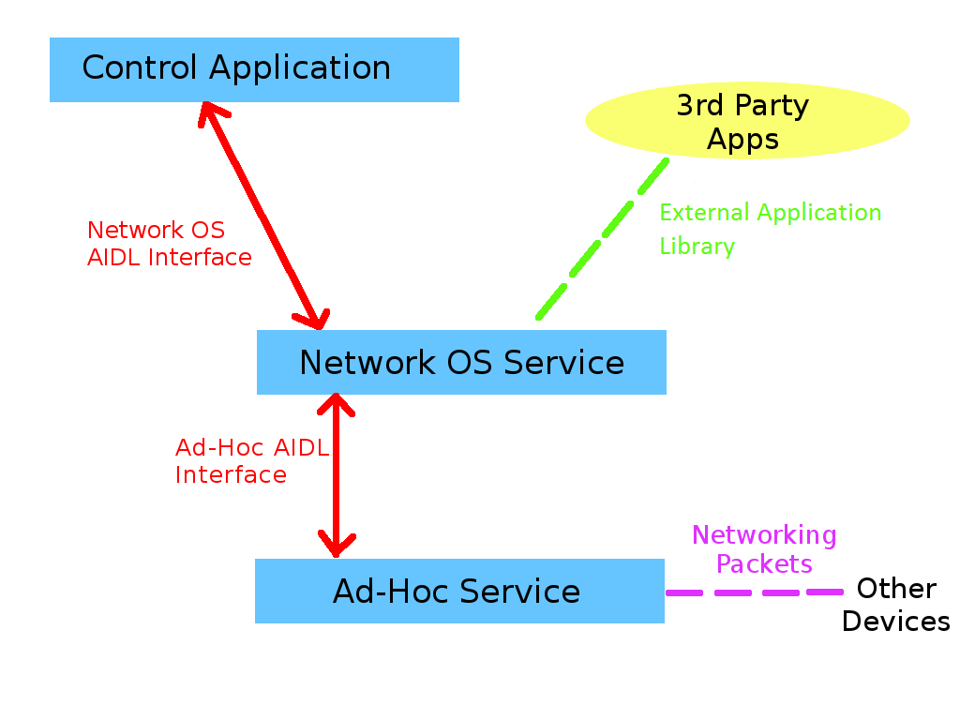
Our Implementation
Software Structure

Slide 11
Our Implementation
Network Mapping:
Central network control required us to be able to dynamically map the ad hoc network
Map management software polls the network
All nodes report immediate peers
Reports are returned to device initiating refresh
Map Management software is housed in the network operating system
Our implementation was of questionable efficiency, but functional

Slide 12
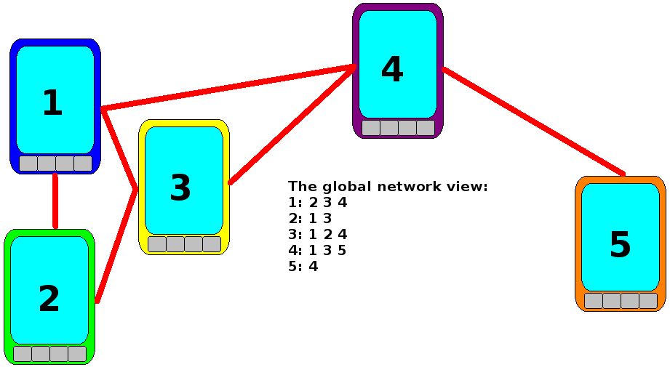
Our Implementation
Network Mapping

Slide 13
Our Implementation
Packet Forwarding Layer
Was partially developed by Paul Baskett and other MU students prior to the REU program
Work this summer included modifying that code for compatibility with the SDN structure
Includes code and AIDL methods for:
Adding and removing forwarding table entries
Sending data packets for 3rd party applications
Sending special purpose packets (route testing, mapping)
Connection testing

Slide 14
Our Implementation
Network Operating System
Arbitrates communication between:
Control software
Packet forwarding layer
3rd party applications
Is the basis for many possible, future network functions
Load balancing
Real time network traffic information
Security and address resolution
Maintains an external application interface and virtual subnetworks

Slide 15
Our Implementation
Network Operating System
To use our external application interface, developers must:
Implement the callback interface
Override the dataReceived(byte[]) method
Create a NetworkConnection object
Application Context
String describing virtual network name
Instance of the Callback interface
Now, they can:
Find other devices running the same application – getPeers()
Learn about the local device – getMyContactInfo()
Send data to other devices – sendData(byte[])

Slide 16
Our Implementation
Network Operating System
Virtual subnetworks
Tracked by the network OS
Each application has its own virtual subnetwork
Enables the control software to set application specific routing rules
Network OS can more effectively monitor network use
3rd party applications can easily locate other devices running the same application
Possibly, 3rd party application can set network traits
Speed vs reliability, etc.

Slide 17
Our Implementation
Control Software
Unlike on a traditional network, no dedicated server
A random device must be chosen to run the network’s control software
Our Specific Implementation
Focused primarily on exhibition and direct user control
Did not implement large scale algorithms
Mostly a proof of concept

Slide 18
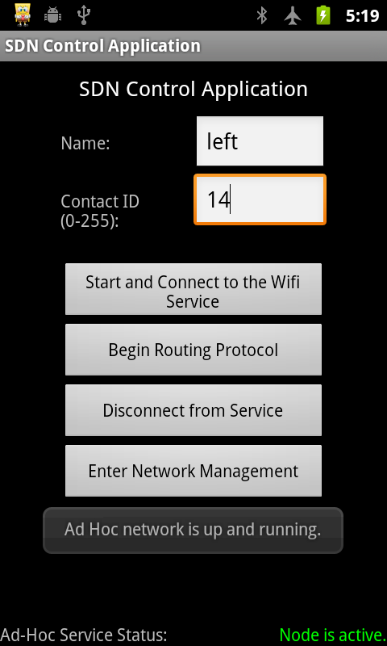
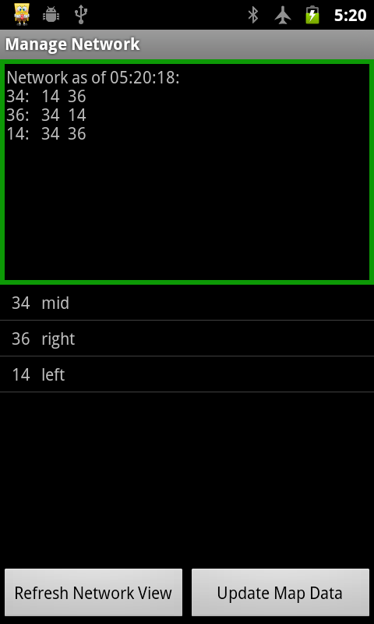
Launching the software system via the control application
Viewing the network map, and a list of network device names.

Slide 19
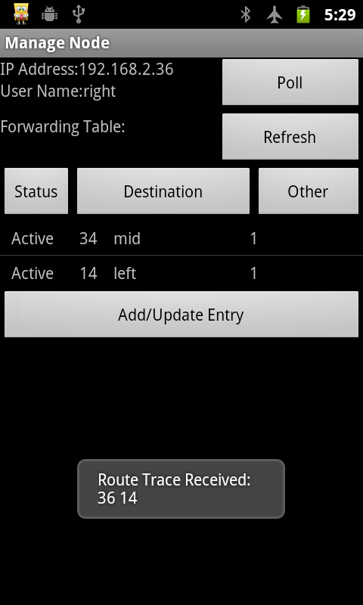
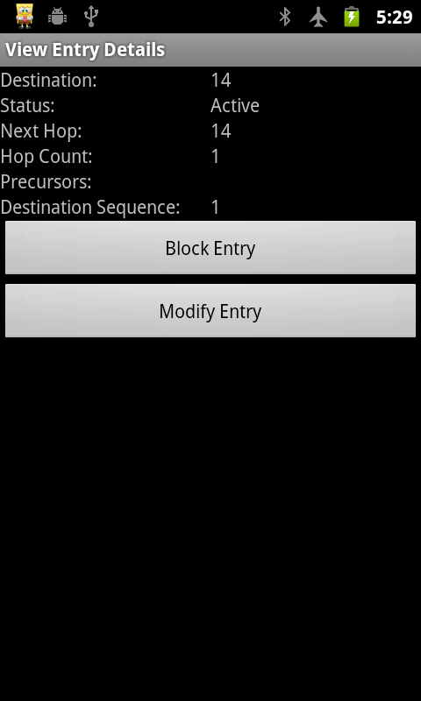
Viewing the forwarding table for a network device, while receiving a route tracing packet
Viewing the details of a forwarding table entry.

Slide 20
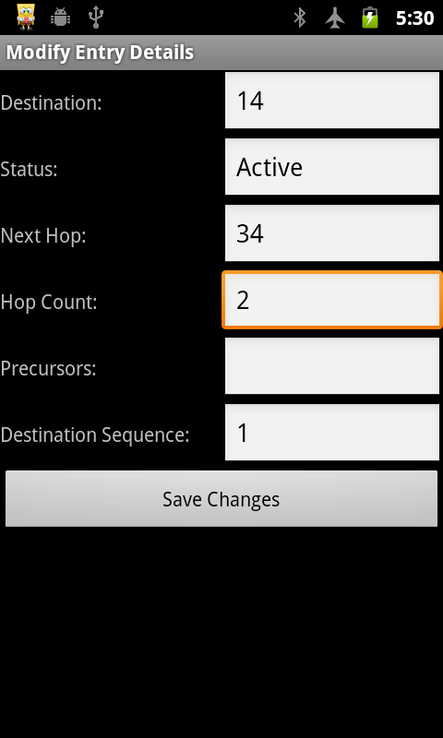
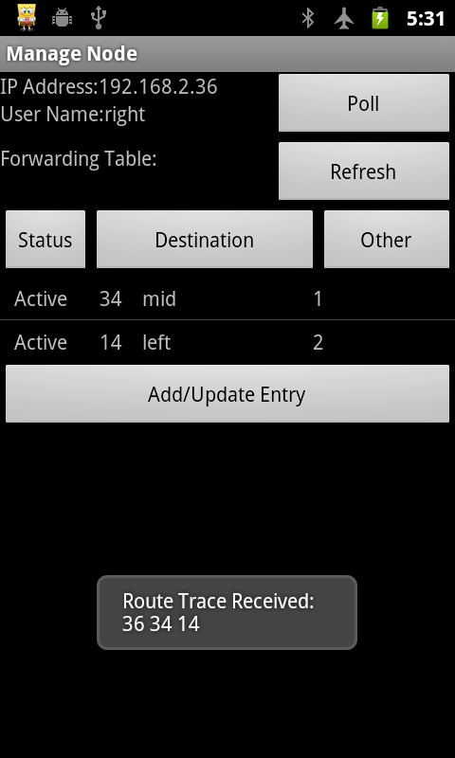
Modifying a forwarding table entry
Viewing the modified forwarding table, and receiving an affirmative route tracing packet

Slide 21
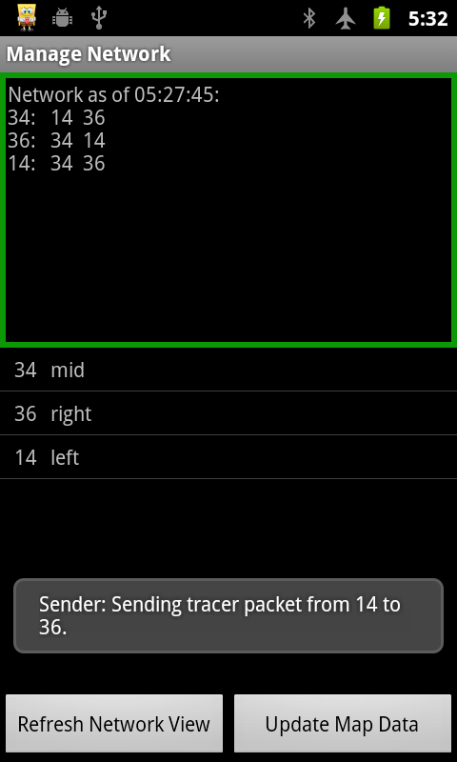
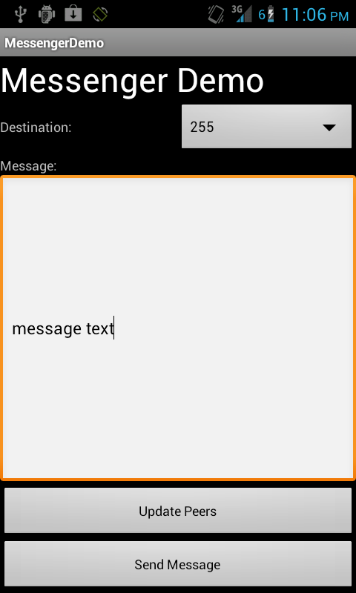
Sending a route tracing packet, to test whether set rules are being adhered to.
An example 3rd party application, which sends and receives text messages.

Slide 22
Results
Efficiency
Data transfer rates were cut in half
Not very efficient – but that is okay, it’s a proof of concept
Functionality
Successfully able to dynamically modify network routes
Greatly simplified network use for 3rd party applications
Applications can use an ad hoc network in just a few lines of code
Success!

Slide 23
Final Comments
REU Program
Learned how to abstract complex systems
Improved understanding of programming in the Android environment
Greatly improved understanding of networking technology
Research experience for grad school (?)

