Slide 1
Development of a wireless body area sensing system for alcohol craving study
Master’s Project Defense
Sandeep Ravi
Advisor: Dr.Yi Shang

Slide 2
Overview
Introduction
Related Work
System Architecture and Implementation
Comparison and Analysis of Initial vs. Current Design
Summary and Future Work

Slide 3
Motivation
What is Alcohol Craving ?
NIAAA reports 18 million people in U.S to have an alcohol use disorder or alcohol dependence
NIDA reports $30 billion health care costs to treat alcohol craving
Current Methods in Alcohol Craving studies cannot accurately predict the Alcohol Craving Episodes

Slide 4
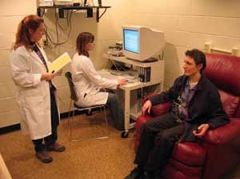
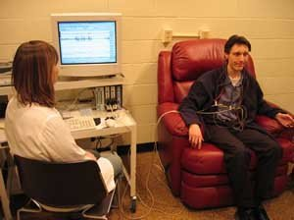
Laboratory Assessment

Slide 5
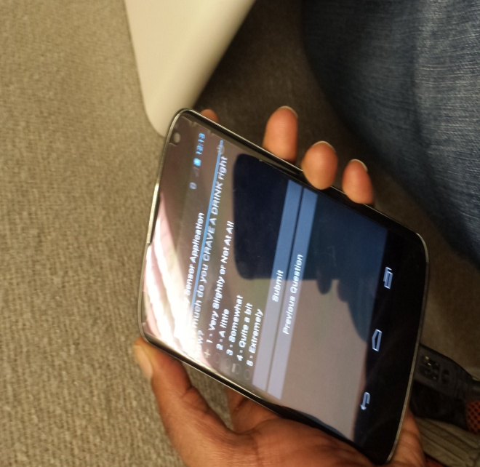
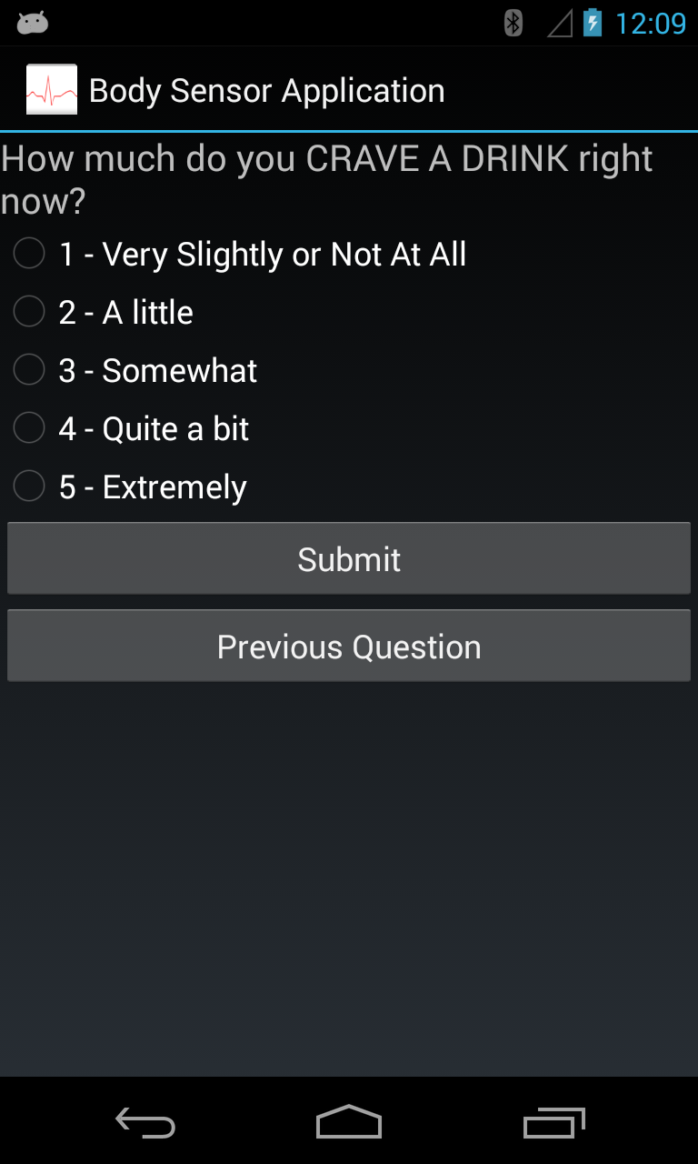
Ambulatory Assessment

Slide 6
Project Goals
System to analyze real-time factors and predict craving episodes
Short-Term Goals:
  Implement a Body Area Sensing System
  Framework to facilitate prediction & intervention
  Make the system “Contextual-Aware”
Long-Term Goals:
  Complete system with prediction and intervention capability

Slide 7
Overview
Introduction
Related Work
System Architecture and Implementation
Comparison and Analysis of Initial vs. Current Design
Summary and Future Work

Slide 8
Related Work
“IPainRelief - A pain assessment and management app for a smart phone implementing sensors and soft computing tools”, by Rajesh and Joan, SRM University, India, ICICES,2013.
  A Pain Assessment and Management App “IPainRelief” for a Smart phone
  Uses Fuzzy Expert Systems
  No experimental results

Slide 9
Related Work (cont’d)
“Daily Mood Assessment based on Mobile Phone Sensing,” by Xu et al., Tsinghua University, China, International Conference on Wearable and Implantable BSN’s, 2012.
  Framework to detect mood related mental health problems
  Tested on 15 users for 30 days
  Accuracy of 50% with Naïve Bayes Classifier

Slide 10
Overview
Introduction
Related Work
System Architecture and Implementation
Comparison and Analysis of Initial vs. Current Design
Summary and Future Work

Slide 11

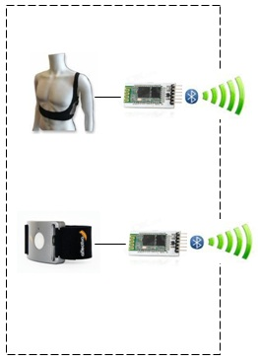
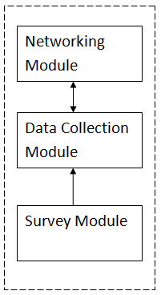


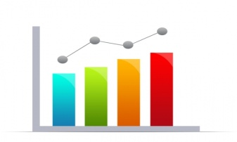

System Architecture
External Sensors
Smart Phone
GPRS or Wi-Fi
Equivital EQ02 Life monitor
Web
Server
Affectiva Q Sensor
Data Visualizations
Flat File System

Slide 12
System Implementation
External Sensors
Smartphone
    Network Module
    Data Collection Module
    Survey Module
Web Server

Slide 13
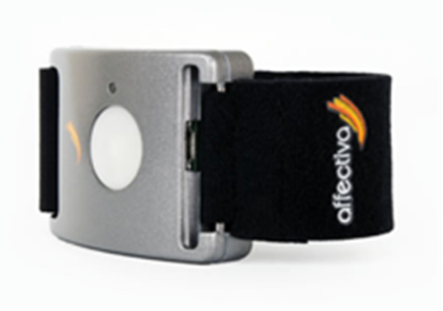
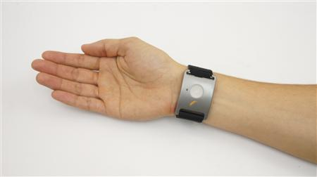
Affectiva Q Sensor
Bluetooth RFCOMM Protocol
Accelerometer data
Electro Dermal Activity (EDA)
Temperature.
Transmission rate 2hz-32hz

Slide 14
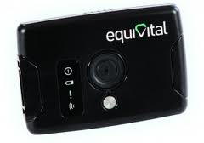
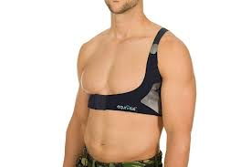
EQ02 Life Monitor
Bluetooth RFCOMM Protocol
Heart Rate derived from ECG , Impedance
Breathing Rate derived from ECG, Impedance
Body Position and Body Movement
GSR(Galvanic Skin Response)
Core Temperature and Skin Temperature
Requires Equivital SDK for parsing the raw data from the SEM

Slide 15
System Implementation
External Sensors
Smart Phone
    Network Module
    Data Collection Module
    Survey Module
Web Server

Slide 16
Smart Phone
Central Point in Body Area Sensing System
Android Application : Body Sensor Application
Internal Sensors:
    Accelerometer
    Light
    Pressure
    GPS
Android Application-Three Modules:
    Network Module
    Data Collection Module
    Survey Module

Slide 17
Module Core Functionality
Sensor Service
Storage and Processing
Survey Module
Self-assessment + Random Surveys
Network Module
Connectivity with External Sensors
Data Collection Module
Smartphone sensors + location

Slide 18
Network Module
Uses android.bluetooth API
Establishes RFCOMM channels with external Sensors
Connects to sensors through service discovery
Transfers data from external sensors
Multi-threaded framework
Transmits physiological data
  “Wed Nov 06 09:30:01 CST 2013,MovingSlowly,Side,0.0,0.0,-1.0,0.0,100.0,0.0,-1.0,60.0,90.0,365.171560326186”

Slide 19
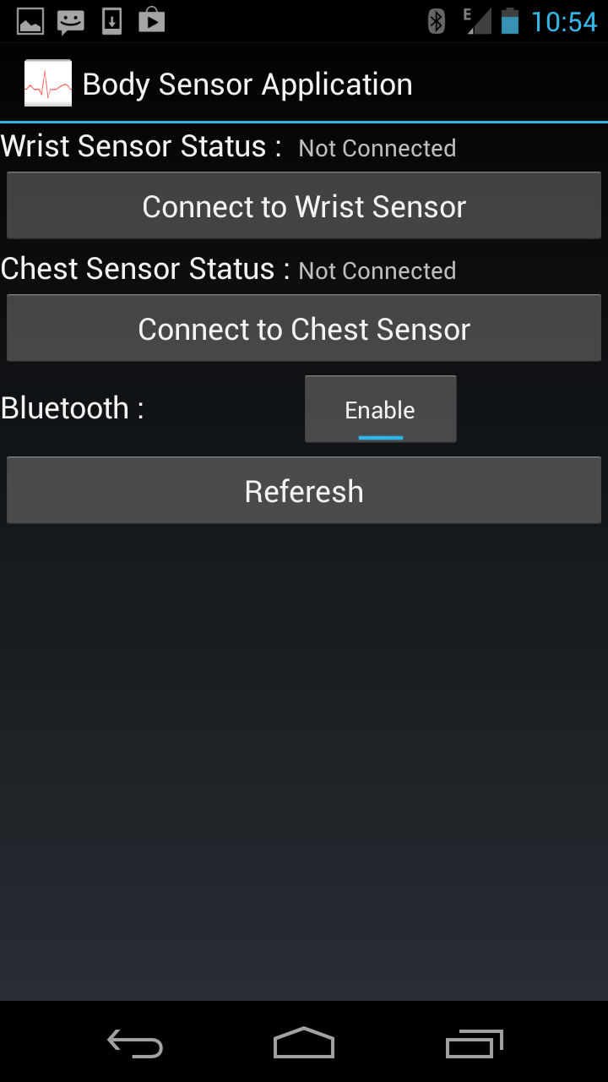
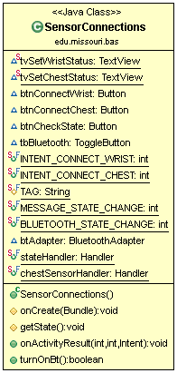
Sensor Connections Activity

Slide 20
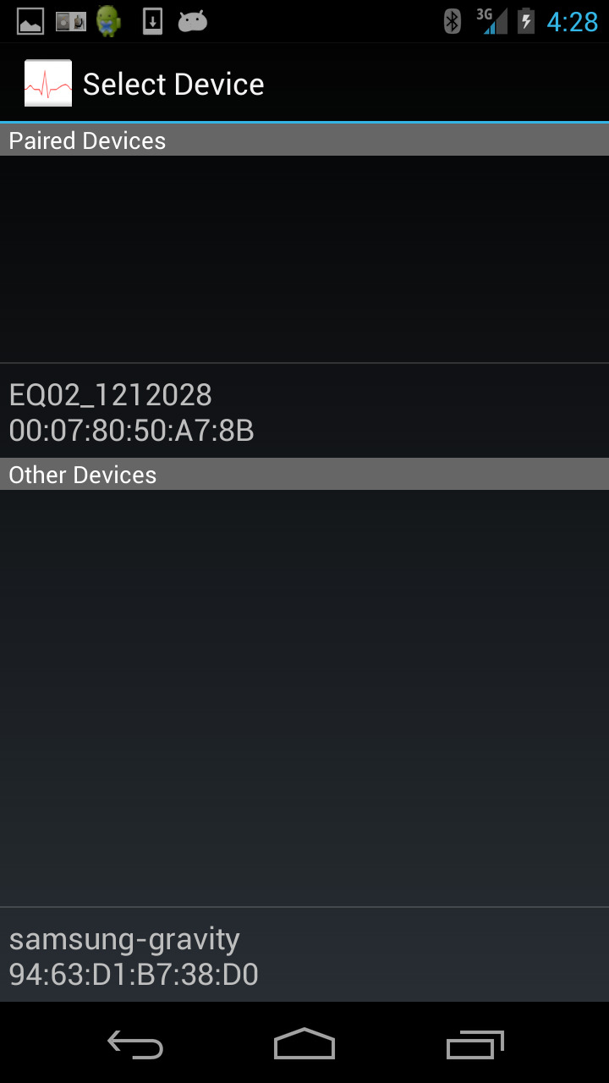
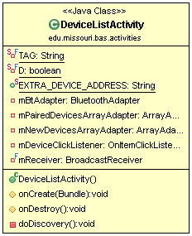
Device List Activity

Slide 21
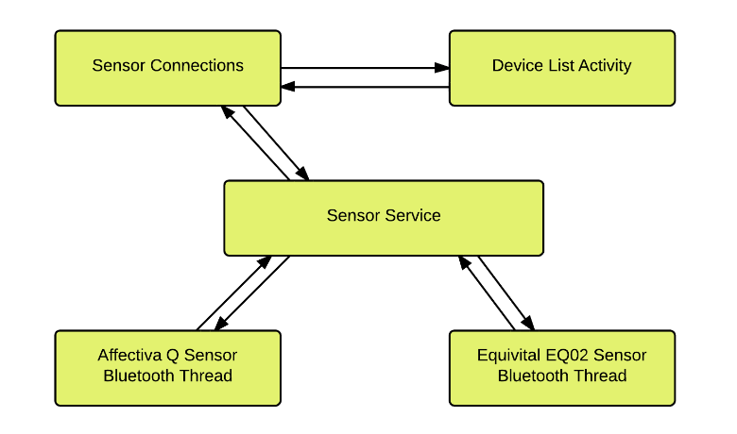
Data Flow Diagram
MAC address
Bluetooth State
MAC address
Bluetooth State
MAC address
Bluetooth State
MAC address

Slide 22
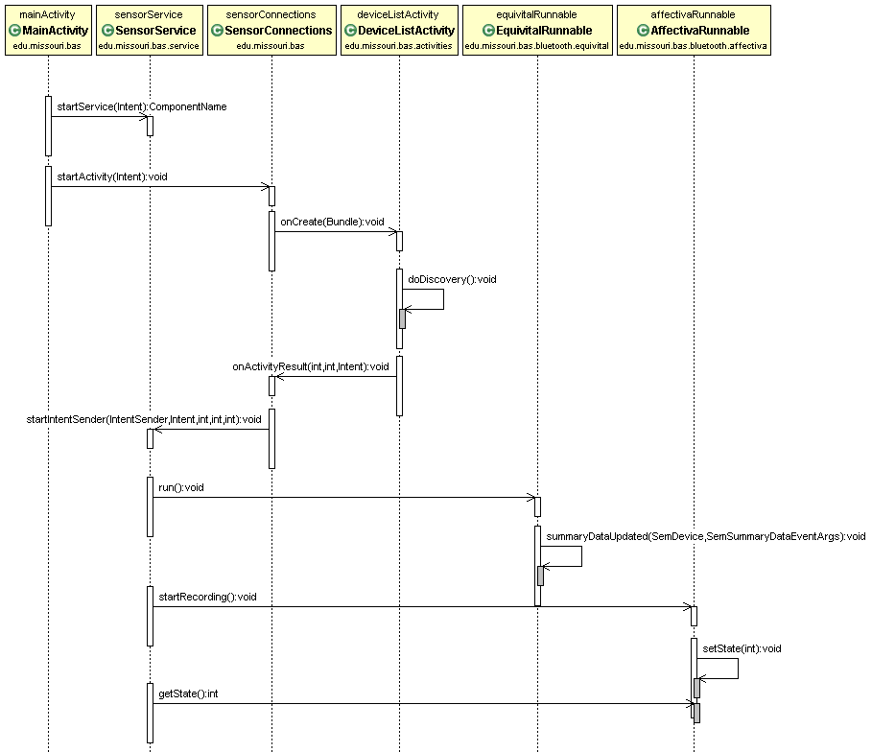
Sequence Diagram

Slide 23
System Implementation
External Sensors
Smart Phone
    Network Module
    Data Collection Module
    Survey Module
Web Server

Slide 24
Data Collection Module
Data from External Physiological Sensors
Data collection from Internal Sensors
    Accelerometer
    Light
    Pressure
    Location Co-ordinates
Survey Data

Slide 25
System Implementation
External Sensors
Smart Phone
    Network Module
    Data Collection Module
    Survey Module
Web Server

Slide 26
Survey Module
Consists of a series of self-assessment surveys and a random survey.
Analyze and records a subject’s emotional state during assessment of the subject.
Surveys are loaded from XML files and are parsed by SAX parser
Six types: Morning Report, Initial Drinking, Mood Dysregulation, Craving Episode and Alcohol Consumption.

Slide 27
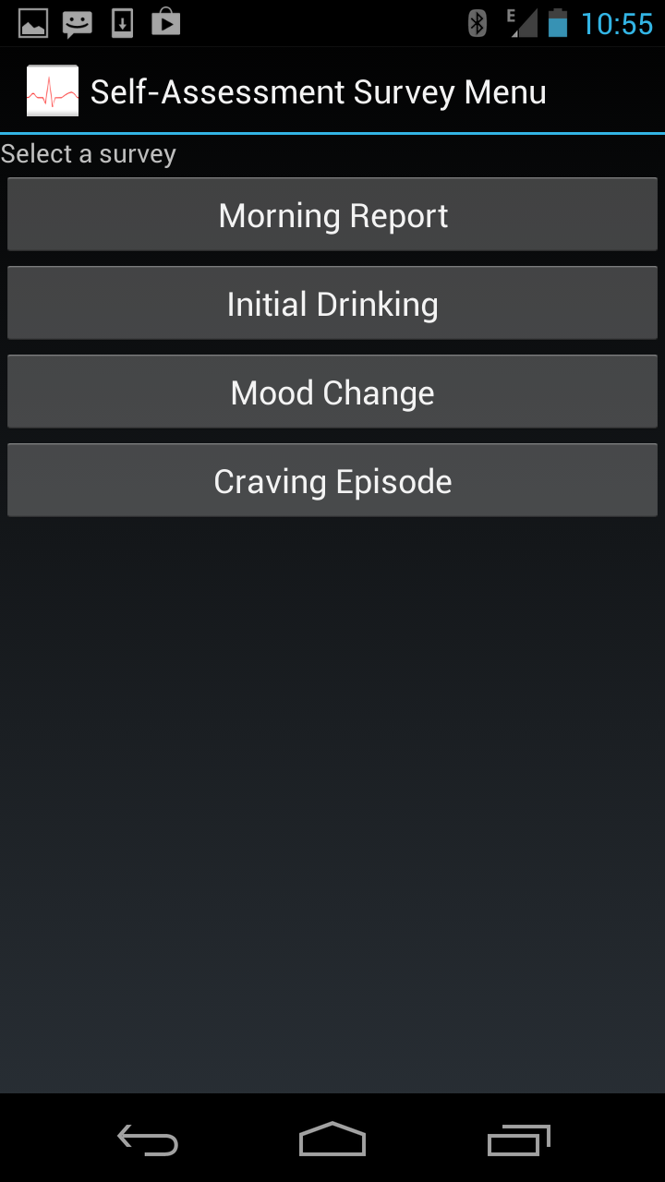
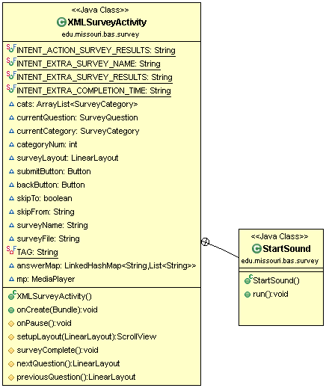
XML Survey Activity

Slide 28
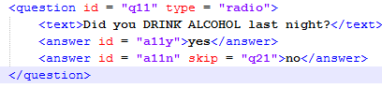
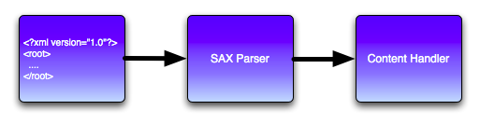
SAX Parser

Slide 29
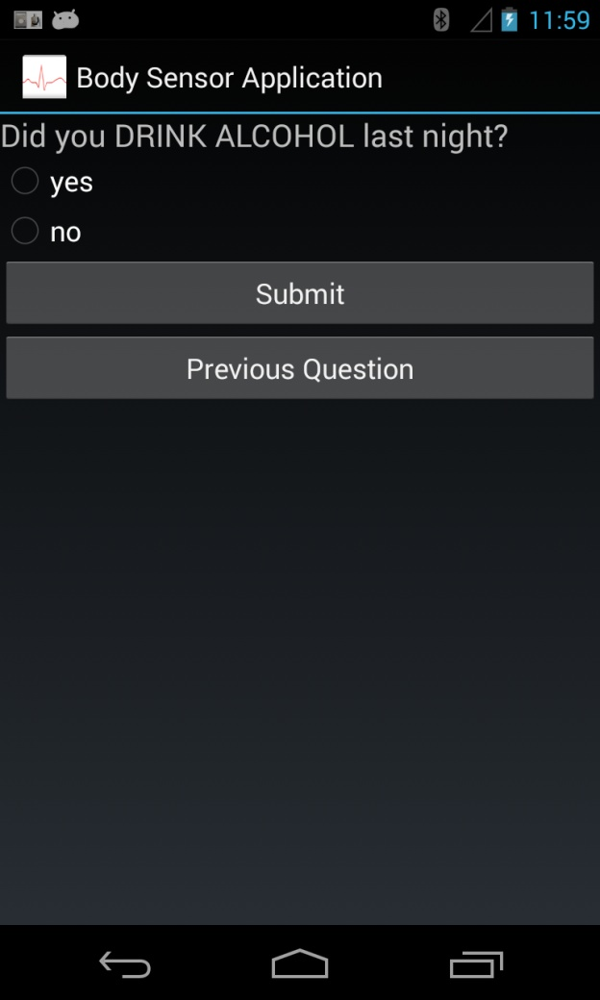
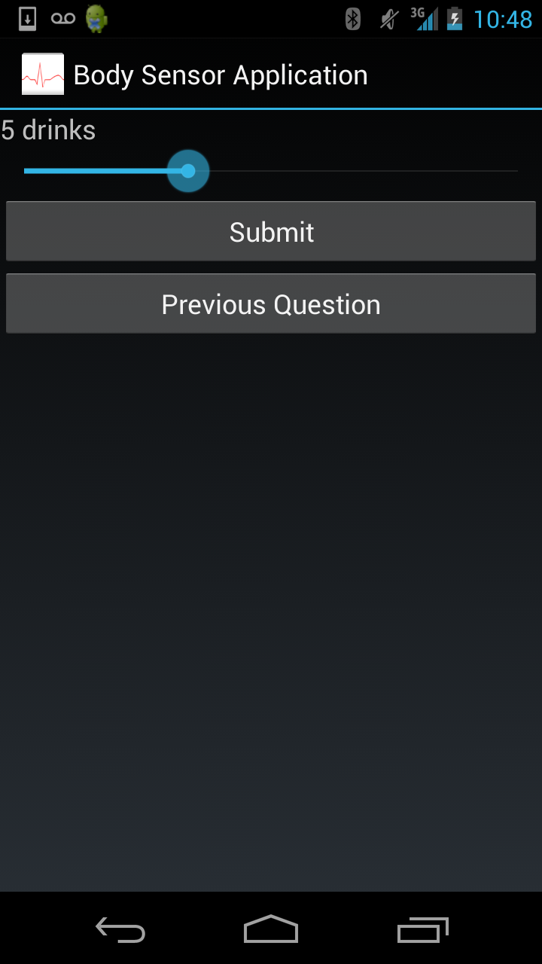
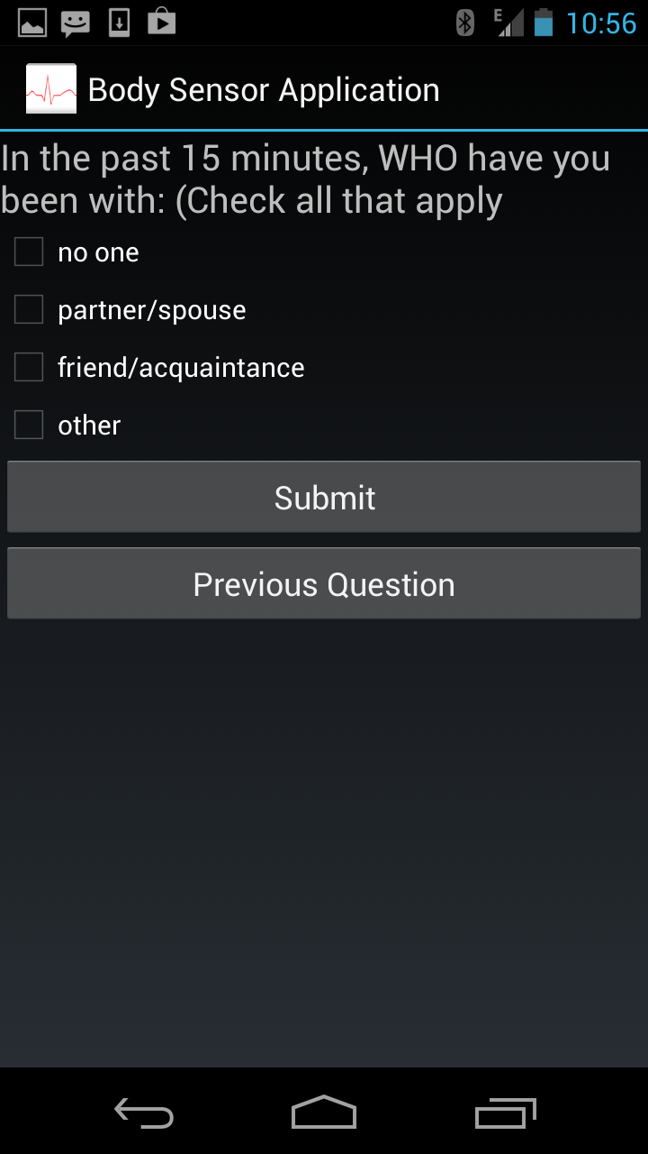
Survey Question Types

Slide 30
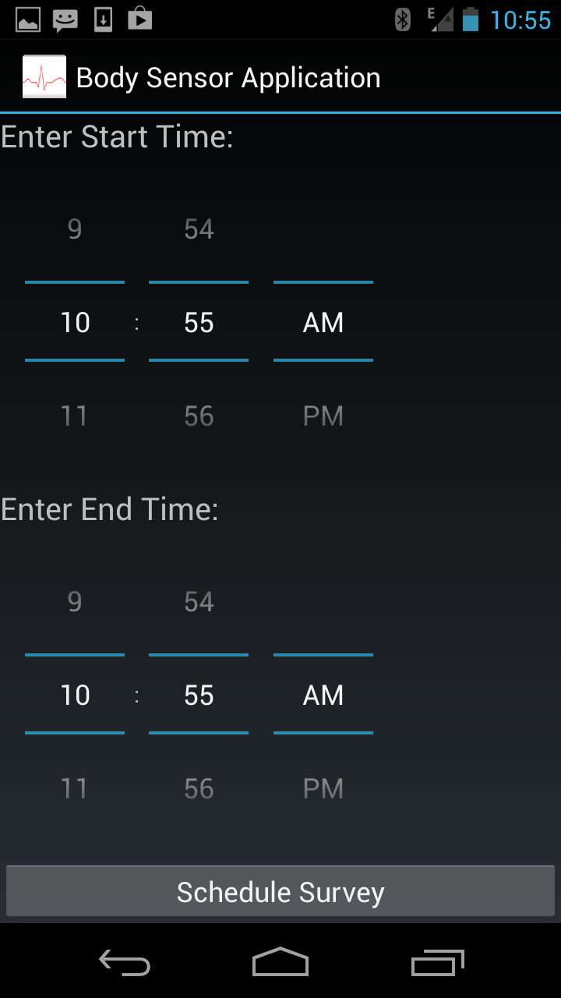
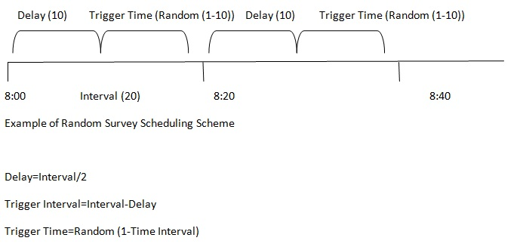
Random Survey

Slide 31
System Implementation
External Sensors
Smartphone
    Network Module
    Data Collection Module
    Survey Module
Web Server

Slide 32
Web Server
Implemented in PHP
Collects Physiological and Emotional data
Flat file system
Real-Time Visualizations using High Charts JS and Google Maps

Slide 33
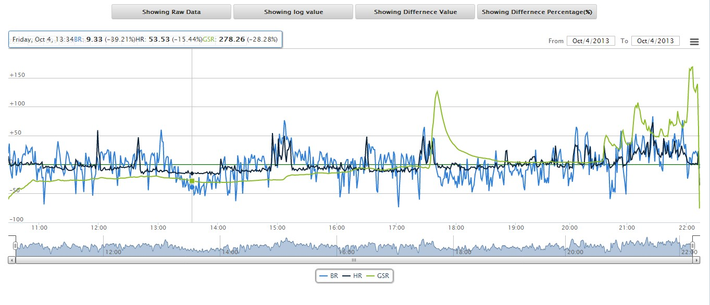
An example of sensor data real-time visualization

Slide 34
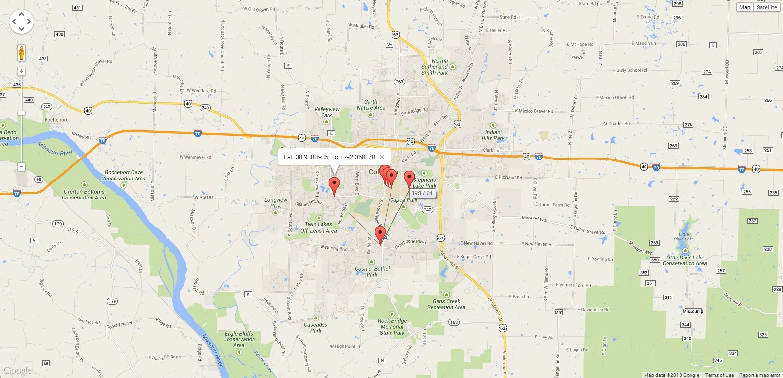
An example of sensor data real-time visualization

Slide 35
Implementation Challenges
Memory Leaks
  Severity: causing the application to crash after 1-3 hours
  Identification
      Analyzing the Applications Heap Dump using Memory Analyzer(MAT)
      Analyzing the Application Log
        E.g., “09-16 01:40:57.287: D/dalvikvm (26990): GC_CONCURRENT freed 402K, 5% free 9261K/9728K, paused 4ms+3ms, total 36ms”
      Using methods in runtime class.
        freeMemory() and totalMemory() methods to get the current runtime memory usage of the application

Slide 36
Implementation Challenges (cont’d)
Power Consumption
Severity: Highly power consuming resources 3G and GPS, significantly drains the battery life
Initial Design:30 sec retrieval
Activity Recognition is an built-in Android service which can be accessed by any application running on Android OS.
Activities: In vehicle, On Bicycle ,On foot , Tilting , Still
A background service and client are needed to access the Activity Recognition Service.

Slide 37
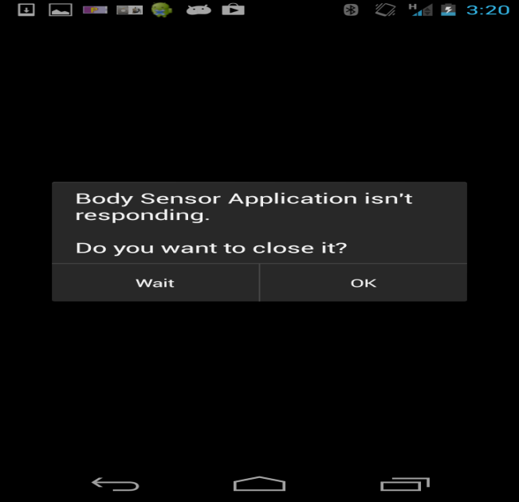
Implementation Challenges (cont’d)
Responsiveness
Severity: Frequent access of network can lead to Application Not Responding Error
Buffers were implemented to reduce the overall usage of the network.

Slide 38
Overview
Introduction
Related Work
System Architecture and Implementation
Comparison and Analysis of Initial vs. Current Design
Summary and Future Work

Slide 39
Comparison of CPU and 3G energy consumption with vs. without activity recognition
CPU: 12.5% reduction 3G: 85.3% reduction

Slide 40
Power Consumption of Body Sensor Application with vs. without activity recognition
Power consumption reduced by 82.9 %

Slide 41
Comparison of CPU and 3G energy consumption with vs. without buffer
CPU: 82.9 % reduction 3G: 40% reduction

Slide 42
Power Consumption of Body Sensor Application with vs. without buffers
Power consumption reduced by 27.6 %

Slide 43
Overview
Introduction
Related Work
System Architecture and Implementation
Comparison and Analysis of Initial vs. Current Design
Summary and Future Work

Slide 44
Summary
The Body Area Sensing System has been deployed and it was observed to successfully collect emotional and physiological data
The Body Sensor Application has been observed to maintain a multiple Bluetooth Connections with external Sensors
Reliable connection for 11-12 hrs with the external sensors
Interesting co-relation were observed between GSR(Skin Conductance) and Alcohol Craving.

Slide 45
Future Work
A Predictive Model to detect Alcohol Craving will be included.
Geo-fencing will be included to provide accurate real-time interventions
The data packets sent to the server will be encrypted

Slide 46
References
Rajesh, M. ; Dept. of Computer Sci. & Eng., SRM Univ., Vadapalani, India ; Muthu, J.S. ; Suseela, G., “ IPainRelief -A pain assessment and management app for a smart phone implementing sensors and soft computing tools”, Information Communication and Embedded Systems (ICICES), 2013 International Conference 2013.
Yuanchao Ma Dept. of Comput. Sci. & Technol., Tsinghua Univ., Beijing, China Bin Xu ; Yin Bai ; Guodong Sun ; Run Zhu , “ Daily Mood Assessment Based on Mobile Phone Sensing”, 2012 Ninth International Conference on Wearable and Implantable Body Sensor Networks.

Slide 47
Questions ?

