Slide 1
Investigating Methods of Layering a Mobile Application to Increase its Accessibility to Elderly
Brian On Professor Skubic
Alice Wong Mentor: Moein Enayati
Chandler Mendenhall

Slide 2
Problem
Older adults have difficulty learning to use mobile technologies

Slide 3
Solution: Multi-Layered Interfaces
Multi-Layering
  Divide features of full application into >=2 layers
Learn on simplified base layer
Move onto increasingly complex/functional layers
  Step-wise, incremental learning

Slide 4
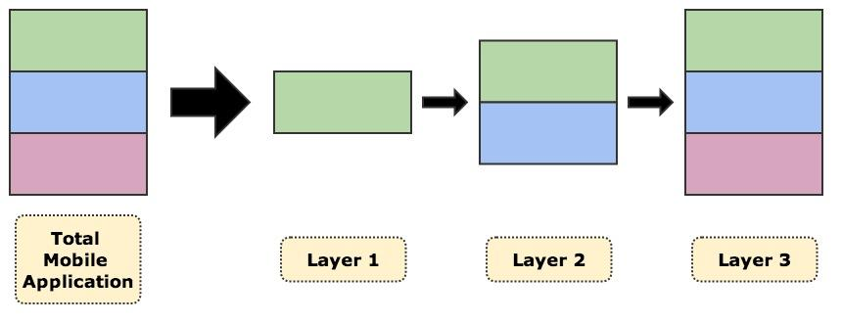
Multi-Layered Interfaces cont.

Slide 5
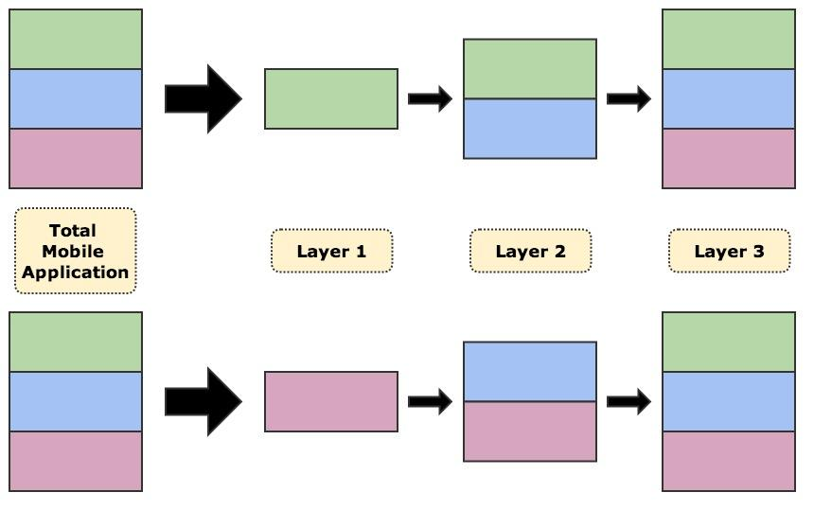
Multi-Layered Interfaces cont.
But... more than one way to layer an application

Slide 6
Research Question
Is there a way to sort the features of a fully functional mobile application into layers that optimizes learnability for elderly?

Slide 7
Research Question cont.
We investigate two methods of layering…
  Functionality
    Features similar in function go in the same layer
  Complexity
    Features similar in difficulty go in the same layer

Slide 8
Implementation
We created a hybrid mobile application for our study
  Delivers health data in the form of charts to users

Slide 9
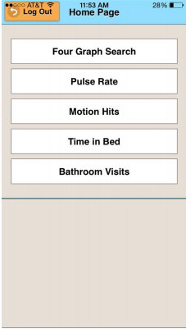

Slide 10
Implementation cont.
From the complete application, we created two different multi-layered versions of the application
  Version A is layered by functionality
    Layer 1: access to all pages, but no graphs
    Layer 2: Graph display + customizability available
  Version B is layered by complexity
    Layer 1: access to four graph pages -- no Four Graph Search or graph customizability
    Layer 2: Four Graph Search + customizability available

Slide 11
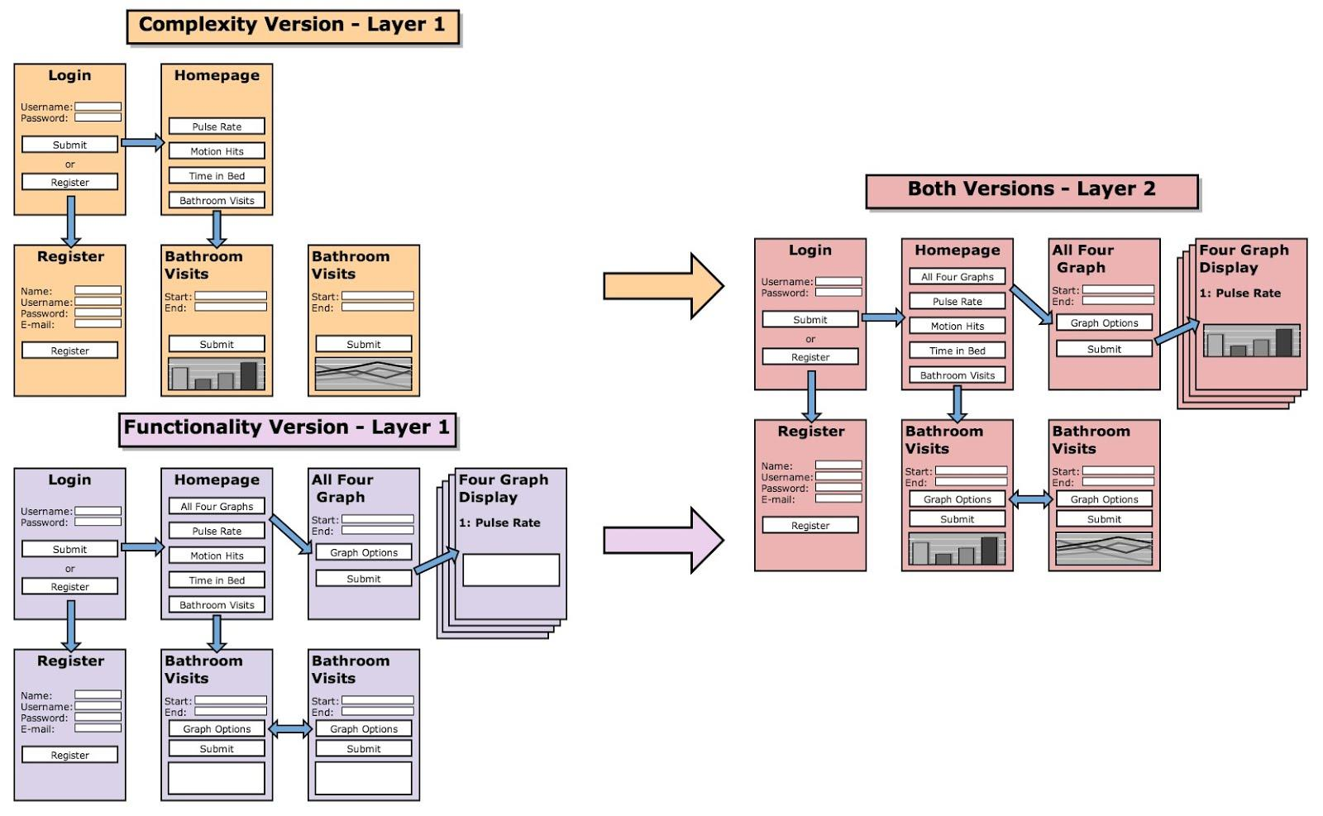

Slide 12
Study
Conducted at TigerPlace with 10 residents
  4 residents used Version A
  6 residents used Version B
Two measures:
  Objective measure: each task timed
  Subjective measure: each participant rated how hard they found the task on a scale of 1 to 5

Slide 13
Study cont.
Residents performed 3 sets of 2 tasks (can be composed of several subtasks)
  First set on the first layer
  Second set on the second layer
  Third set after ~5 minute break on second layer
First and second sets composed “Initial Task Set”
  The order of the tasks differed depending on version participants used
  Overall tasks were the same
Third set composed “Retention Task Set”
  Performed on 2nd layer (full application)
  Same tasks + order for both groups

Slide 14
Objective Results
Tasks 1 - 6: Initial Task Set
Tasks 7 - 11: Retention Task Set
Order of Initial Task Set tasks depended on version (tasks are displayed in order presented to Version A participants)

Slide 15
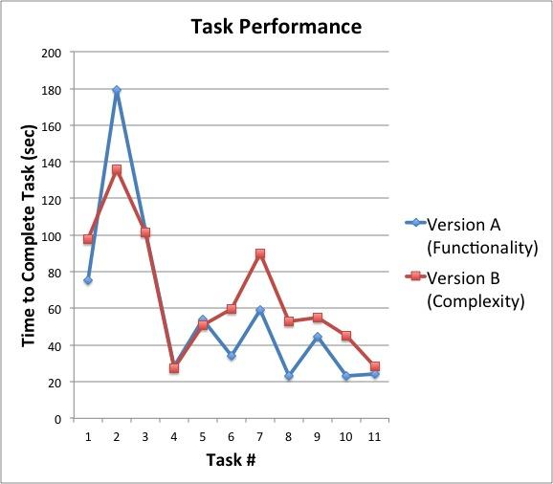
Legend:
Tasks 1 - 6: Initial Task Set
Tasks 7 - 11: Retention Task Set

Slide 16
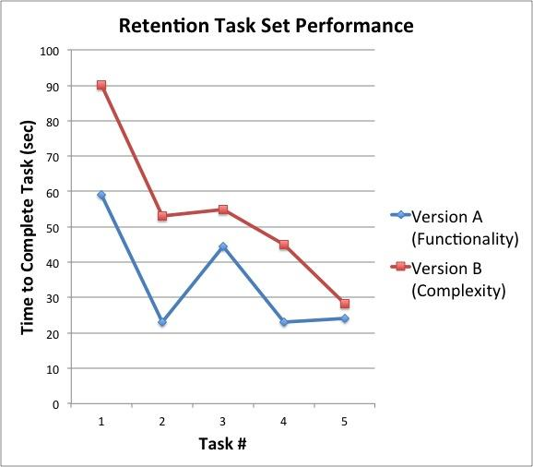

Slide 17
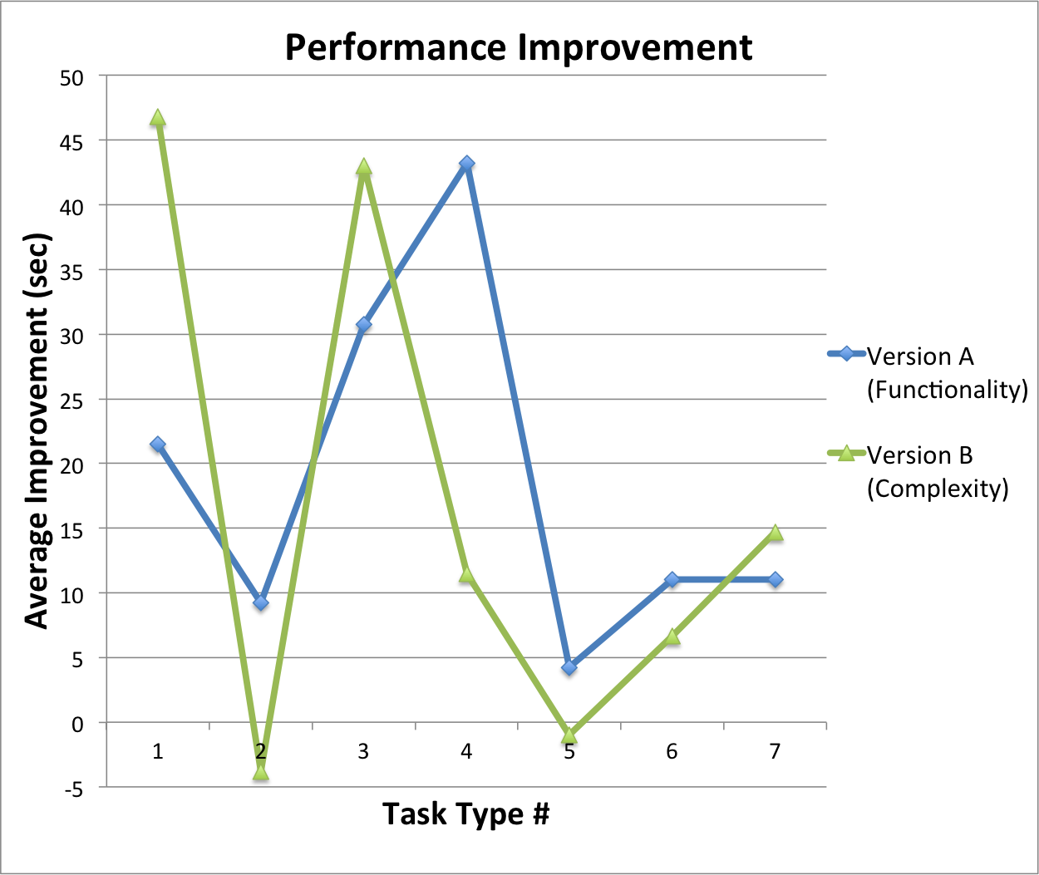
Legend:
1, 2, 3 - basic graph display
4 - graph customizability
5 - data statistics
6, 7 - graph interpretation
Notes:
Retention vs Initial

Slide 18
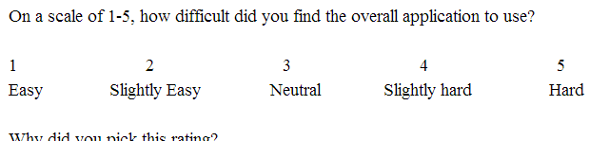
Subjective Results
After each task, asked participant to rate how difficult they found the task they performed
Most rated using the application and performing the tasks as easy (1)

Slide 19
Future Work
The data suggests functionality is a better way of layering
However, the data is not statistically significant
Further testing with more people would need to be done for more conclusive results

Slide 20
Any questions?

Slide 21
References
Kurniawan, Sri, Murni Mahmud, and Yanuar Nugroho. "A study of the use of mobile phones by older persons." CHI'06 extended abstracts on Human factors in computing systems. ACM, 2006.
Kang, Hyunmo, Catherine Plaisant, and Ben Shneiderman. "New approaches to help users get started with visual interfaces: multi-layered interfaces and integrated initial guidance." Proceedings of the 2003 annual national conference on Digital government research. Digital Government Society of North America, 2003.
Leung, Rock, et al. "Multi-layered interfaces to improve older adults’ initial learnability of mobile applications." ACM Transactions on Accessible Computing (TACCESS) 3.1 (2010): 1.

