Slide 1


Thin-client based remote volume visualization over wide-area networks
Jerry Adams,
University of Hawaii
Dr. Prasad Calyam, Ronny Antequera, Eliot Prokop,
University of Missouri

Slide 2
Presentation Outline
Background
Related Work
Problem
Implementation
VNC Encoding Selection Scheme
Shared GPU Virtualization
OpenFlow Controller

Slide 3
Background
Remote Desktop Access (RDA) Applications are prevalent
Achieving best Quality of Experience (QoE) in RDA Applications essential
QoE is an interplay of:
Quality of Application (QoA)
Quality of Service (QoS)

Slide 4
Related Work (1/4)
“Human-Aware and Network-Aware Encoding Selection Scheme for Remote Instrumentation”
Considers both the condition of the network and the human perceived performance of the application
Using RICE application as a case study, proves Human and Network Aware encoding selection is superior

Slide 5
Related Work (2/4)
“ADON: Application-Driven Overlay Network-as-a-Service for Data-Intensive Science”
QoS improvements via Software-defined network (SDN) techniques.
Case study tested network improvements over four different RDA applications

Slide 6
Related Work (3/4)
“Remote Desktop QoE Optimization Through Context Awareness”
3Q Decision Tree Model proposed
QoA and QoS improved to optimize the overall QoE

Slide 7
Problem
What are ways to improve the overall quality of experience of a RDA application?

Slide 8
Problem
What are ways to improve the overall quality of experience of a RDA application?
Dynamic VNC encoding selection scheme
Shared GPU Virtualization
OpenFlow Controller

Slide 9
RIVVIR Application (1/2)
Remote Interactive Volume Visualization Infrastructure for Researchers (RIVVIR)
Access remote computing resources and data intensive applications
Used as a case study to test and verify improvements

Slide 10
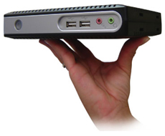
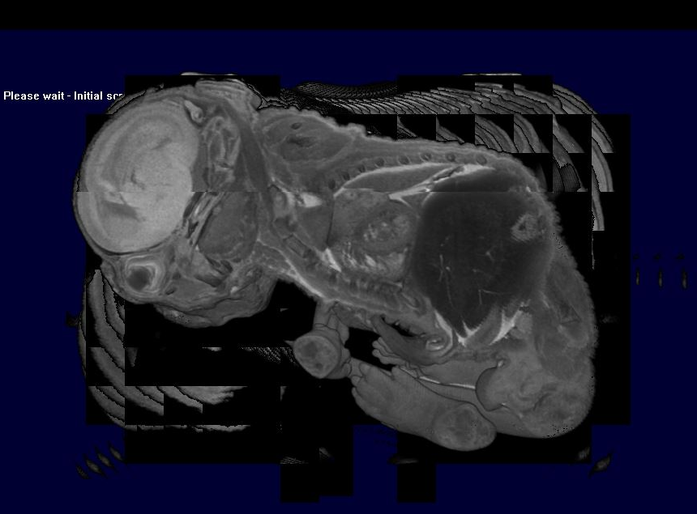
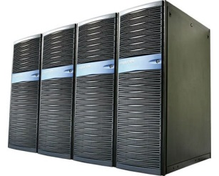


RIVVIR Application (2/2)
Computing Resources @ OSU
Thin client end users @ MU

Slide 11
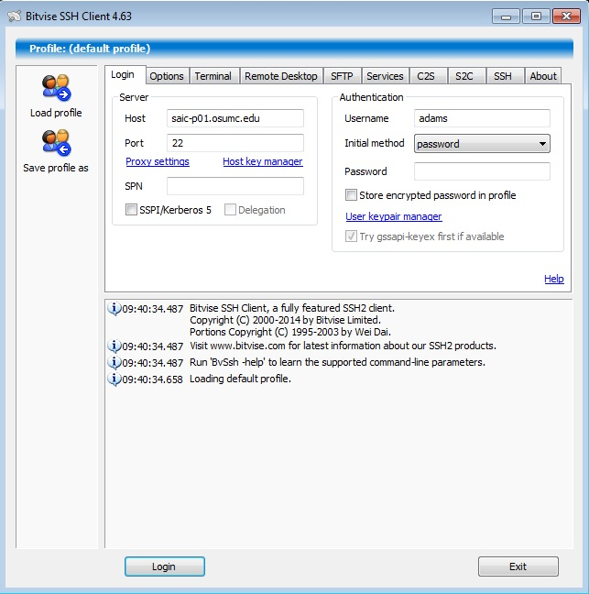
Connecting to RIVVIR (1/4)

Slide 12
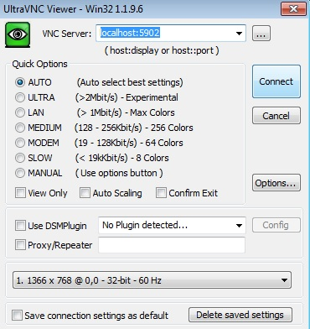
Connecting to RIVVIR (2/4)

Slide 13
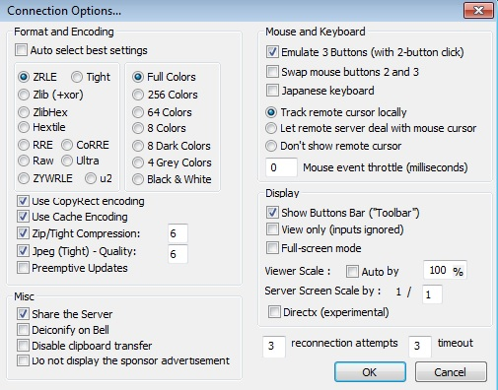
Connecting to RIVVIR (3/4)

Slide 14
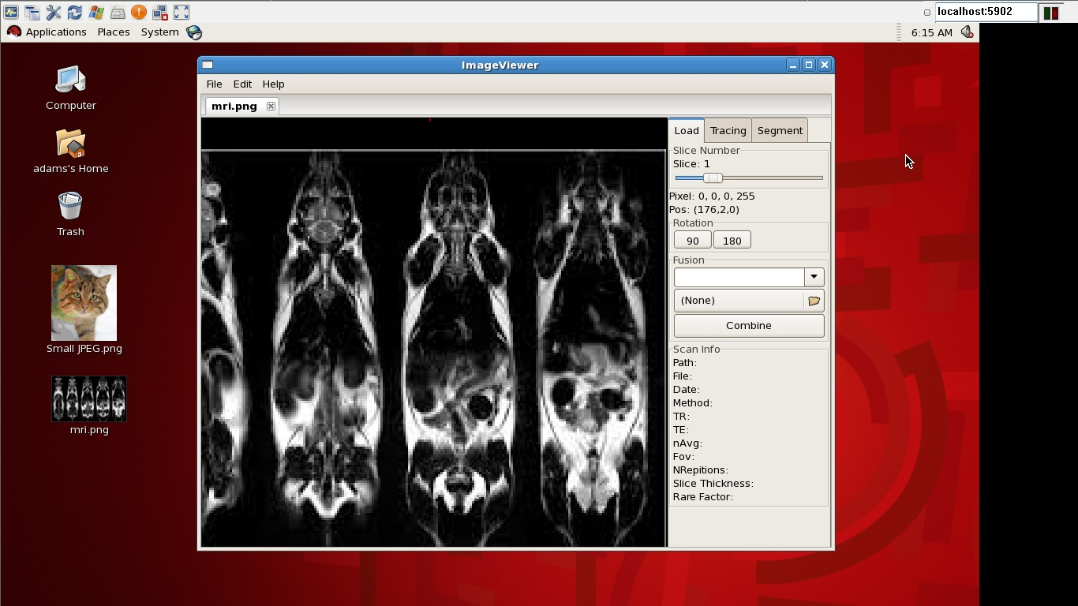
Connecting to RIVVIR (3/4)

Slide 15
VNC Encoding
VNC – Open source remote control protocol, based on Remote Frame Buffer protocol
Ultra VNC – VNC client that’s used to connect to RIVVIR
Encoding – encoding of pixels to transport the image data

Slide 16
VNC Encoding Schemes
Will be testing 8 encoding schemes:
Tight, ZRLE, Zlib, ZlibHex, Ultra, Hextile, RRE, Raw
Each encoding scheme supports 4 color options:
Full Colors, 256 Colors, 64 Colors, 8 Colors

Slide 17
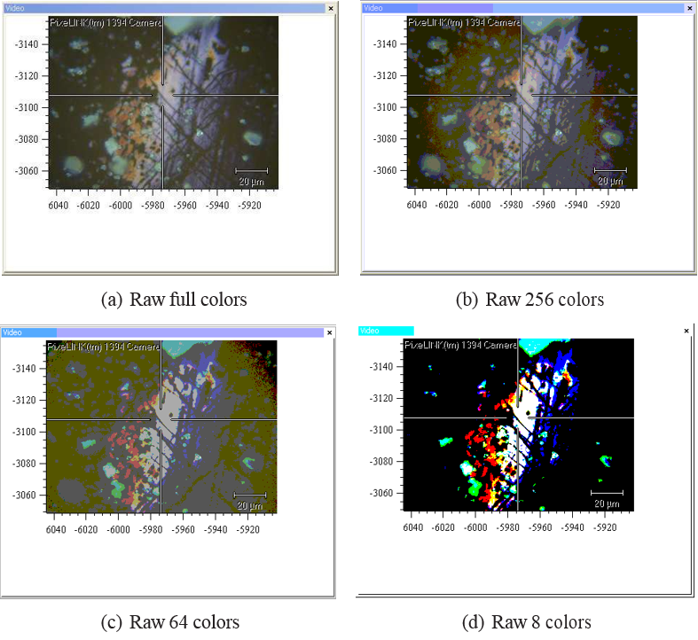

Slide 18
Dynamic VNC Encoding Selection
Have RIVVIR to dynamically choose best encoding scheme based on network conditions such as:
Available Bandwidth
Packet Loss

Slide 19
Preliminary Encoding Decision Rules
^{Available Bandwidth} | Encoding
Available Bandwidth > 1 Mbps | Hextile full colors
256 Kbps > Available Bandwidth > 128 Kbps | ZRLE 256 colors
128 Kbps > Available Bandwidth > 19 Kbps | Tight 64 Colors
19 Kbps > Available Bandwidth > 5 Kbps | Tight 8 colors

Slide 20
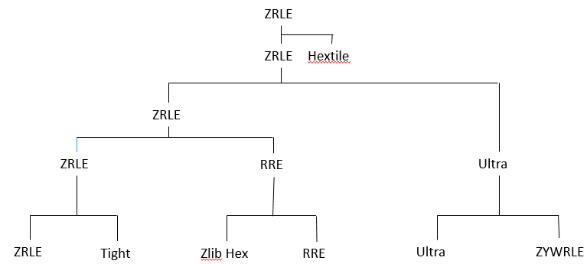
Generic Encoding Selection Algo.

Slide 21
Roadmap for Encoding Selection
Perform more tests of encoding types on different network conditions
Improve decision rules and algorithim

Slide 22
Shared Virtualized GPU
What is shared virtualized Graphics Processing Unit (GPU)?
“Allows a virtual machine (VM) to behave as if it has its own physical, dedicated GPU. The hypervisor (ESXi) sits between the physical GPU and VM, intercepting API calls and translating commands.”
More effective GPU acceleration for VMs than other virtualization methods

Slide 23
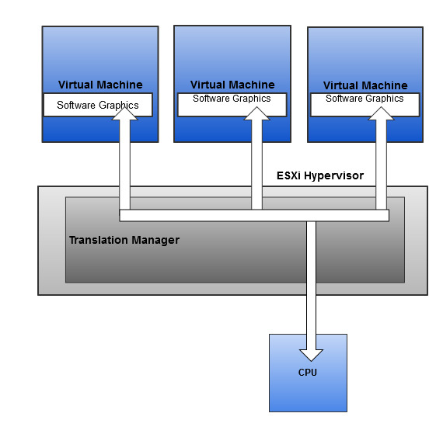
Less effective vGPU methods: Soft PC

Slide 24
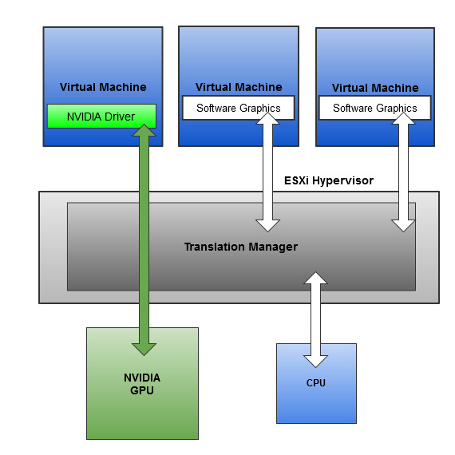
Less effective vGPU methods: GPU Pass-through

Slide 25
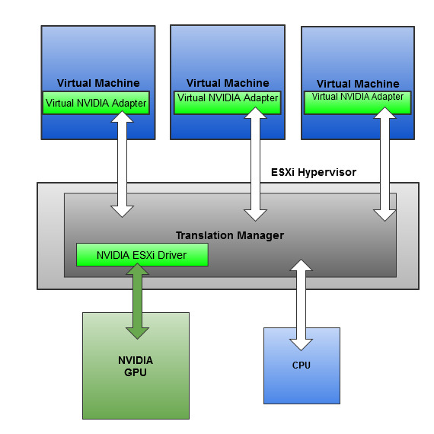
More effective: Shared Virtualized GPU
Notes:
Virtual Graphics adapter created on each VM, commands sent to translation manager on hypervisor. The physical GPU intercepts commands from translator

Slide 26
Test Shared Virtualized GPU
Apply Shared Virtualization GPU to RIVVIR server
Run graphic intensive workloads on RIVVIR
Capture performance metrics such as VM consolidation, response time and remote FPS

Slide 27
Performance Metrics
VM Consolidation - number of VMs that can be supported concurrently on a server until CPU utilization < 80%
Response time - measurement of the VM's response time in seconds from when an image is fully loaded on the remote client
Remote FPS - number of remotely delivered frames per second that correspond to frame updates generated by the server

Slide 28
Roadmap for Shared GPU Virtualization
Perform test on RIVVIR application
Analyze results

Slide 29
OpenFlow
A protocol that gives access to the forwarding plane of a network switch or router over the network
Allows for Software-Define Networking

Slide 30
OpenFlow Controller
OpenFlow Controller – remote software that controls the network switch or router. Many available.
RIVVIR application uses Open Floodlight
Includes a module that enables QoS
Open Floodlight Controller allows for:
Path switching
Bandwidth allocation
Shortest-cost routing

Slide 31
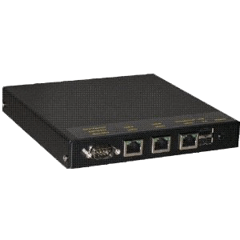
Test OpenFlow Controller
Network Emulator
Computing Resources @ OSU
Thin client end users @ MU

Slide 32
Roadmap for OpenFlow
Test OpenFlow controller on RIVVIR application
Analyze results

Slide 33
Thank you.
Any questions?

Slide 34
3Q Decision Tree Model

