Slide 1
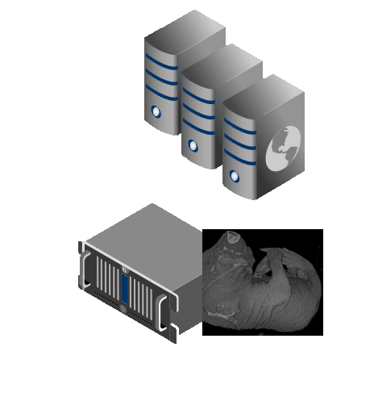
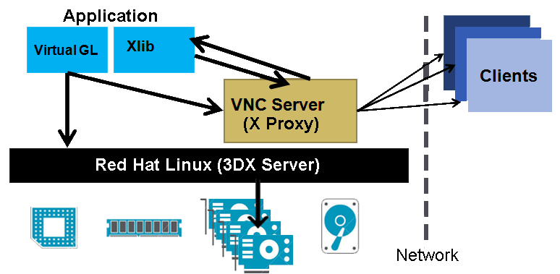
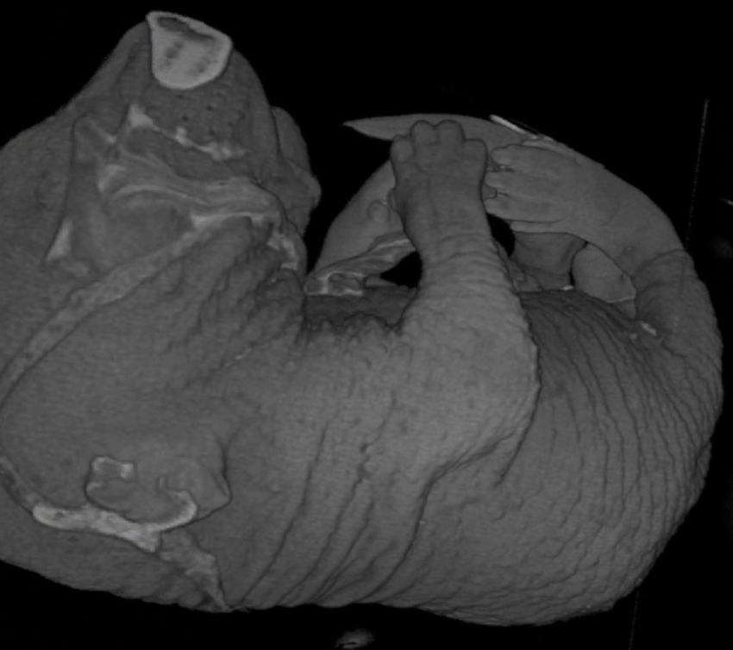
Improving Remote Access of a Data-Intensive Computing Application: Effects of Encoding and GPU Virtualization
Jerry Adams¹, Bradley Hittle², Eliot Prokop³, Ronny Antequera³, Dr.Prasad Calyam³
University of Hawaii-West Oahu¹, The Ohio State University², University of Missouri-Columbia³
Introduction
Remote “Desktop” Access (RDA) with exceptional user Quality of Experience (QoE) is needed for data-intensive computing
Impractical to carry or download for computation
A decision tree model uses context awareness through feedback loops by adjusting Quality of Application (QoA) and Quality of Service (QoS) to improve the overall user QoE
QoE improvements this project explores:
Encoding types
Graphic Processing Unit (GPU) Virtualization
The data-intensive application used as a case study is RIVVIR that is being used in the field of Small Animal Imaging
Encoding
VNC (which uses RFB protocol) is used to connect to server
Encoding refers to the encoding of image data pixels that are generated by RFB and transported by VNC
10 Encoding types: Tight, ZRLE, Zlib, ZlibHex, Ultra, Hextile, RRE, ZYWRLE, CoRRE and Raw
Results
Encoding:
Subjective results show that Tight, Ultra or ZlibHex are the best choice for high latency or low bandwidth networks
Objective results also show the same 3 encoding types are among those that have the fastest response time
Figure 2: Lossless RLE pixel encoding (python.dzone.com)
Case Study: RIVVIR application
Ohio State U.
GPU Virtualization
Hypervisor virtualizes a physical GPU to support multiple virtual desktops
Application and user feel as if they have a dedicated GPU
Remote Interactive Volume Visualization Infrastructure for Researchers (RIVVIR)
Remote access via thin-clients
GPU-based data-intensive volume visualization for MRI viewing (typical file size is ~0.5 GB)
Figure 4: Objective results from wired network experiment; Tight encoding has least bandwidth consumption at .45 Mbps
GPU Virtualization:
Results show that RIVVIR appears capable of handling five clients simultaneously without loss of QoE
U. of Missouri
Figure 3: GPU virtualization setup on RIVVIR using a 3D X Server and VNC Server
Experiments
Encoding: Testing of encoding types on different networks
Objective metrics: Bandwidth Consumed in Mbps
Subjective metric: User QoE in tournament model
GPU Virtualization: Variety of end devices connected to virtual desktop displays
Objective Metrics: GPU Utilization %, Concurrent User Load
Internet
This material is based upon work supported by National Science Foundation under award numbers CNS-1205658 and CNS-1359125. Any opinions, findings, and conclusions or recommendations expressed in this publication are those of the author(s) and do not necessarily reflect the views of National Science Foundation.
Figure 1: End devices at Uni. Of Missouri access MRI’s over the Internet with RIVVIR hosted at The Ohio State University

