Slide 1
Midterm Presentation
A centrality measure to quantify social capital in a network
Undergraduate Researchers:
Graduate Student Mentor:
Faculty Mentor:
Jordan Cowart, Katie Allmeroth
Krist Culmer
Dr. Wenjun (Kevin) Zeng

Slide 2
Outline
Introduction
Key terms
The problem
Project Goals
Related Work
Data Collection & Analysis
Data Acquisition
Tools for Analysis
Future Work

Slide 3
Outline
Introduction
Key terms
The problem
Project Goals
Related Work
Data Collection & Analysis
Data Acquisition
Tools for Analysis
Future Work

Slide 4
Key terms
Centrality – The criticality (importance) of a node’s position within a network.
Social Capital – The value of a node based on its ability to influence other nodes and access resources from diverse areas (communities) of the network.
Community – “. . . a community is generally thought of as a part of a network where internal connections are denser than external ones.”
Notes:
Nodes typically cluster together around a resource or function

Slide 5
Two measures of centrality
Eigenvector Centrality (EVC)
Principal Component Centrality (PCC)

Slide 6
The problem
Current measures of centrality take into account the node’s “connectedness” but do not consider a node’s “community membership”
Want to incorporate social capital when computing a node’s centrality
Why is this important?

Slide 7
Project Goals
1. Extract Facebook Data
Develop a Web Crawler
Crawl Mizzou’s Facebook page
2. Preliminary Analysis
Apply EVC and PCC to test data/collected data
Develop a visualization of data
Derive any interesting information from the data
3. Expand EVC/PCC to develop a new and improved centrality measure.

Slide 8
Outline
Introduction
Key terms
The problem
Project Goals
Related Work
Data Collection & Analysis
Data Acquisition
Tools for Analysis
Future Work

Slide 9
Related Work
Ilyas et al. [1, 2] demonstrated shortcomings of EVC and then proposed and defined a new algorithm, PCC.
Yang et al. [3] discussed the use of ground-truth (user defined) communities as a bench marking tool for community detection algorithms
Xiao et al. [4] developed an algorithm for gathering Facebook data without the use of Facebook’s API
Salamos et al. [5] shows that there is correlation between “liked” Facebook pages and communities.

Slide 10
Outline
Introduction
Key terms
The problem
Project Goals
Related Work
Data Collection & Analysis
Data Acquisition
Tools for Analysis
Future Work

Slide 11
Data Acquisition
Stanford Large Network Dataset Collection
Provides a collection of more than 50 large network data sets that can include hundreds of thousands of nodes and edges
Mizzou Facebook page
Ground-truth community consisting of individuals stating their education is from Mizzou

Slide 12
Data Acquisition
How would we gather information from Facebook?
Facebook API or web crawler?
Decided to go with a web crawler
Faster – Information is readily available, we don’t have to gather through an app
Other papers had exhibited problems with the Facebook API – they used web crawlers in the end

Slide 13
Data Acquisition - Web Crawler
Features:
Python
Queue based
Breadth-first search (BFS)
Libraries Used:
BeautifulSoup
Built in libraries (URLLib + RE)
Only scrapes data from individuals that attend Mizzou

Slide 14
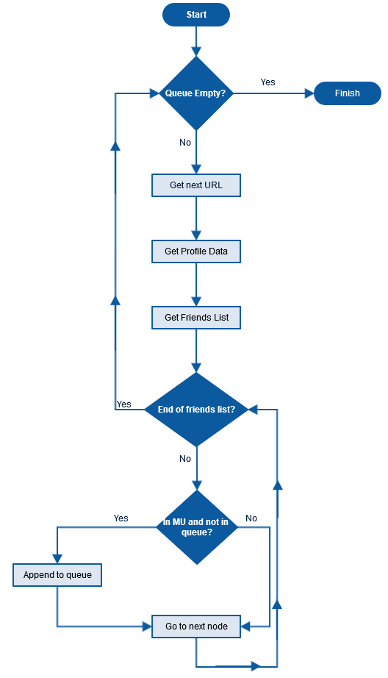

Slide 15
Data Acquisition - Web Crawler
Information to be scraped:
Node’s URL (e.g. - katie.marie.5661)
Major
Gender
Home Town
Friends list
Likes (only those related to Mizzou)
Keep track of nodes in Mizzou / Not in Mizzou / Private

Slide 16
Data Acquisition - Web Crawler
Definition of private:
A page is considered private if the page returns a 404 error or if we cannot access the “All” friends tab

Slide 17
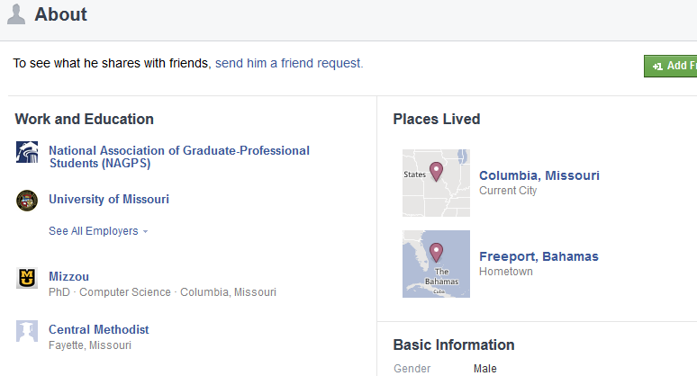
Data Acquisition - Web Crawler
Where exactly are we gathering data from?
Major -> “About” page
Gender -> “About” page
Home Town -> “About” page

Slide 18
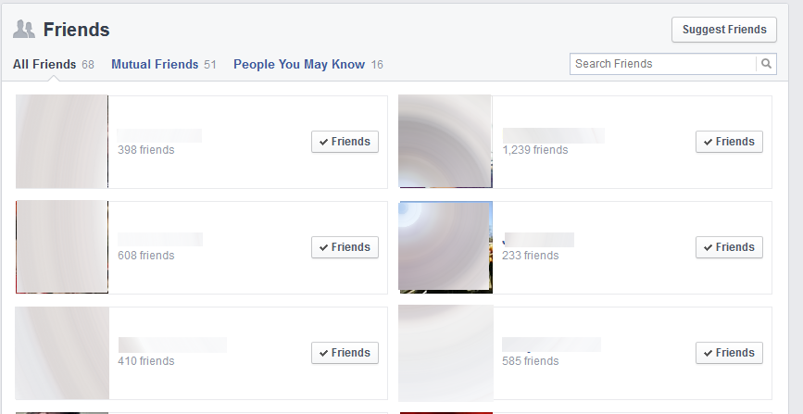
Data Acquisition - Web Crawler
Where exactly are we gathering data from?
Node’s URL -> “Friends” page
Friends list -> “Friends” page

Slide 19
Data Acquisition - Web Crawler
Where exactly are we gathering data from?
Likes -> “Likes” page

Slide 20
Data Acquisition - Web Crawler
Output of data in a text file:
0 2 3 7 8 (Node and friends)
Male (Gender)
Computer Science (Major)
Cobden, IL (Hometown)
Mizzou (Likes)
Able to change major to a college
Computer Science -> College of Engineering

Slide 21
Tools for Analysis - Gephi
An interactive network visualization and exploration platform
Able to change node size, color, and label
Can easily import graphs
Also provides a graph analysis toolkit
Provides centrality measure plugins
Can create our own plugin

Slide 22
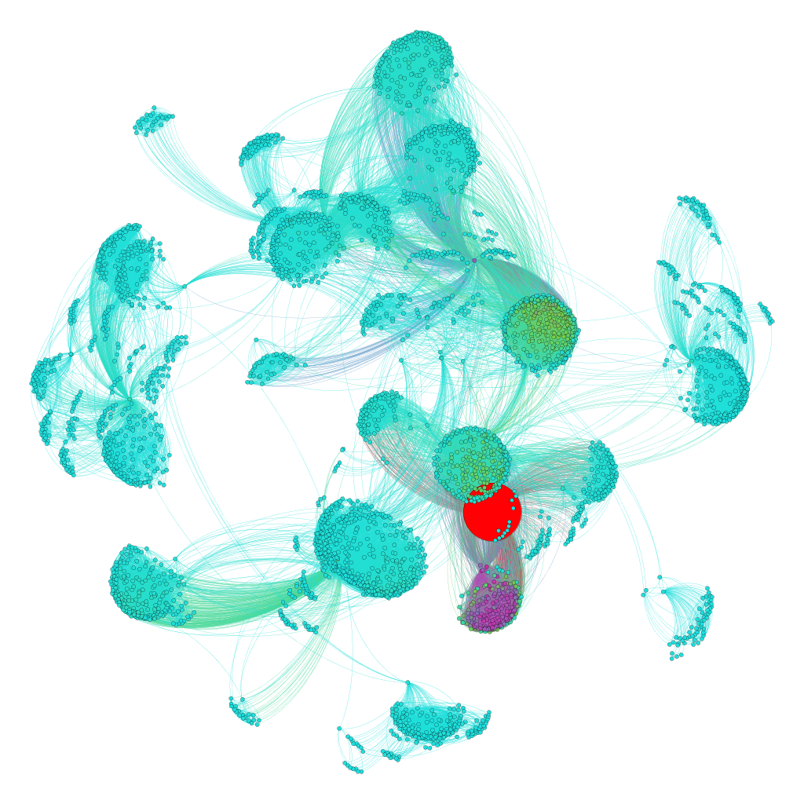
Facebook Graph
Nodes: 4039
Edges: 88234

Slide 23
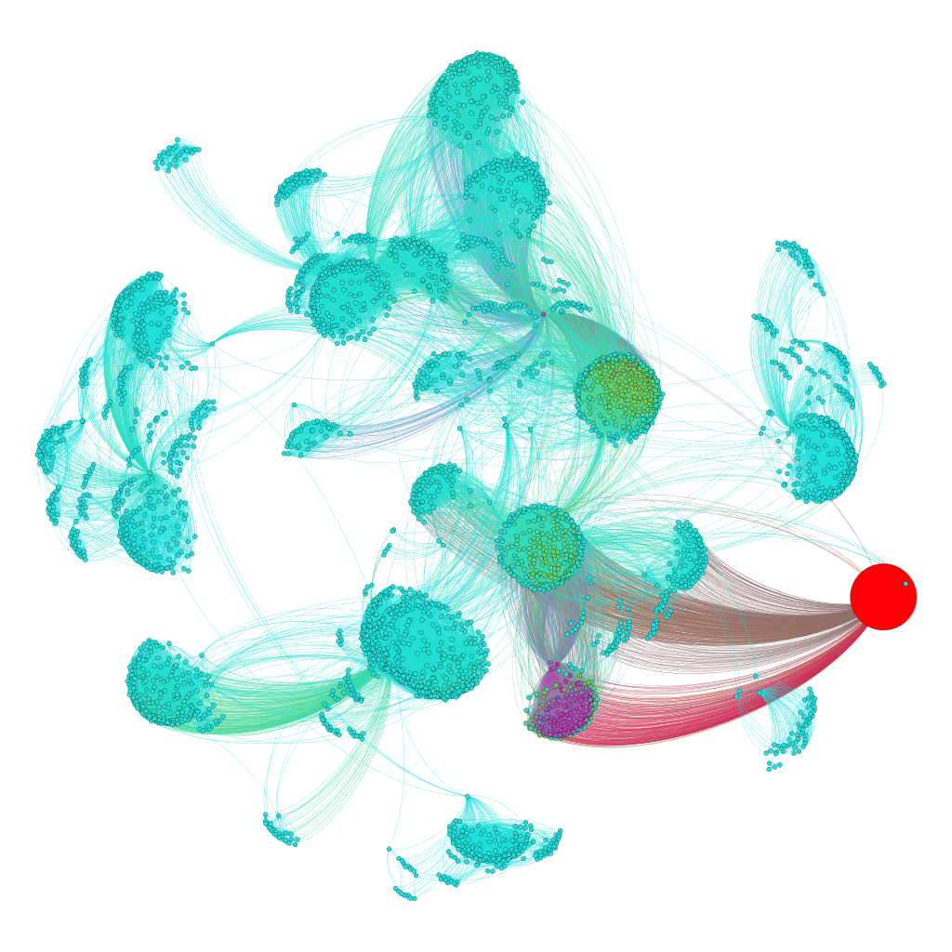
Facebook Graph
Nodes: 4039
Edges: 88234

Slide 24
Outline
Introduction
Key terms
The problem
Project Goals
Related Work
Data Collection & Analysis
Data Acquisition
Tools for Analysis
Future Work

Slide 25
Future Work
Crawl Facebook after receiving permission
Build PCC Plugin for Gephi
Formalize definition of social capital
Define a method for scoring social capital
Apply method to test data and analyze results

Slide 26
Thank you!

Slide 27
References
[1] M. U. Ilyas, H. Radha, “A KLT-inspired Node Centrality for Identifying Influential Neighborhoods in Graphs”, 2010 44th Annual Conference on Information Sciences and Systems, IEEE, Princeton, NJ, March 2010, pp. 1-7.
[2] M. U. Ilyas, H. Radha, “Identifying Influential Nodes in Online Social Networks Using Principal Component Centrality”, The 2011 IEEE International Conference on Communications , IEEE, Kyoto, June 2011, pp. 1-5.
[3] J. Yang, J. Leskovec, “Defining and Evaluating Network Communities based on Ground-truth”, The 12th IEEE International Conference on Data Mining , IEEE, Brussels, Dec. 2012, pp. 745-754.
[4] Z. Xiao, B. Liu, H. Hu, T. Zhang , “Design and Implementation of Facebook Crawler Based on Interaction Simulation”, The 11th IEEE International Conference On Trust, Security And Privacy In Computing And Communications , IEEE, Liverpool, June 2012, pp. 1109-1112.
[5] N. Salamos, E. Voudigari, T. Papageorgiou, M. Vazirgianni,, “Design and Implementation of Facebook Crawler Based on Interaction Simulation”, 2012 IEEE International Conference on Green Computing and Communications, IEEE, Athens, Nov. 2012, pp. 368-371.

