Slide 1
Sensor networks on a mobile platform
Ryan Donnelly

Slide 2
Abstract
Smartphones have many sensors and collectively they can form a sensor network to monitor the environment. A security network was created with three to four smartphones, where the smartphones react to their sensors and collect data. The data can track things like who entered a room and what that person is doing. When the light sensor receives light, the program takes a picture and records audio. One major problem is that the light sensor is inconsistent. All of the data collected from each sensor is returned to one central smartphone. This data, picture and audio files, can then be interpreted. This ad-hoc type of security network could be very helpful if you need to set up quickly.

Slide 3

Sensor Network Structure
S
S
M
S
S

Slide 4
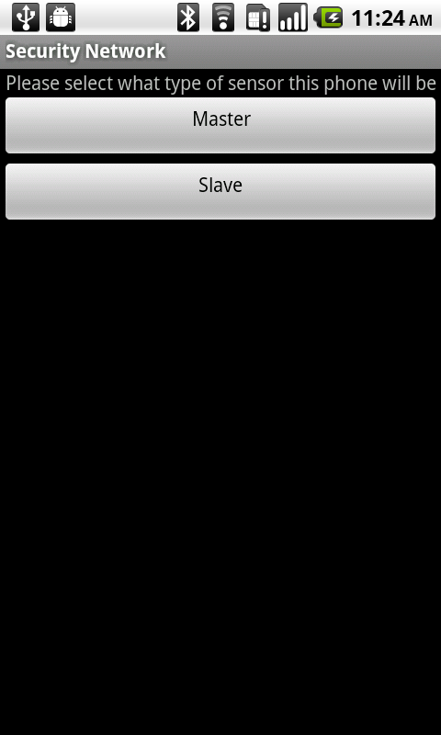
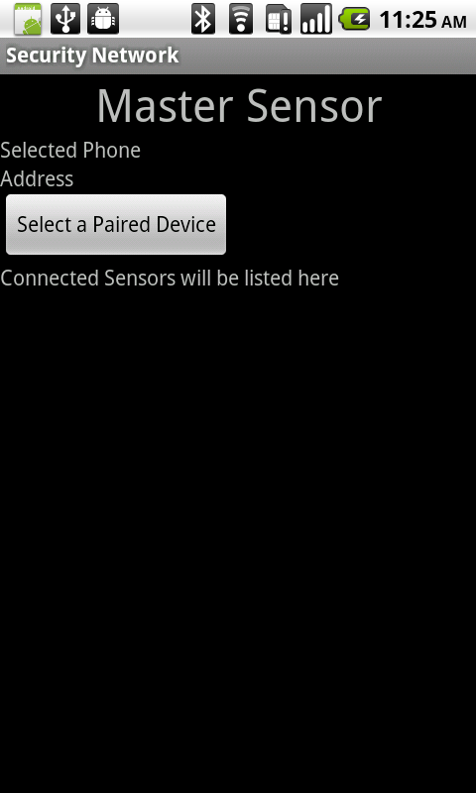
Screenshots
Click to connect to a sensor
Lists all the sensors connected in a list here
File receiving status will be displayed in a toast here

Slide 5
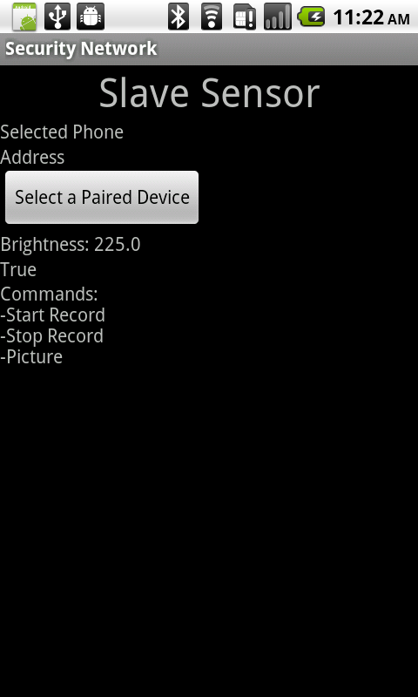
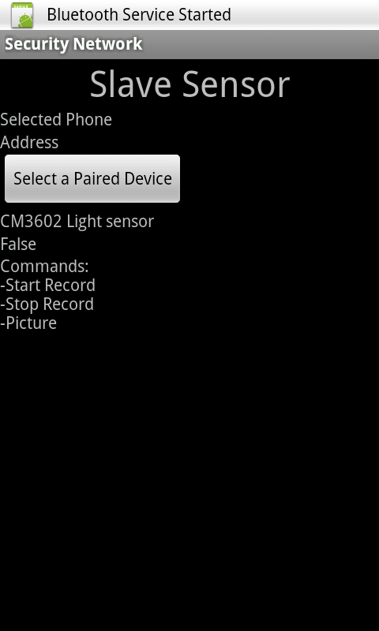
Screenshots
Click to connect to a master sensor
Displays the brightness the light sensor is receiving
Displays the brightness in a true-false way

Slide 6
Results
Before current plan: Acoustic Geolocation
Current plan: Light sensor very inconsistent
The application will sometimes not gather all the data it should
Still has bugs

