Slide 1


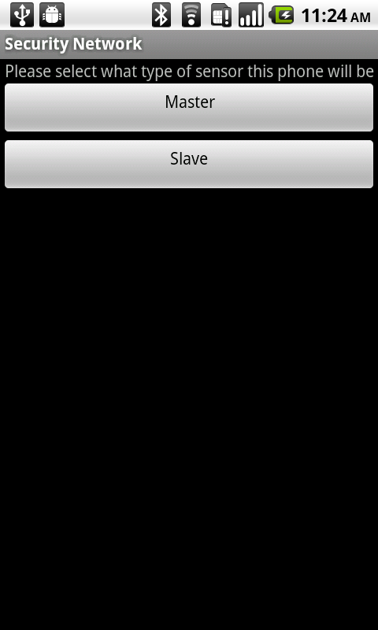
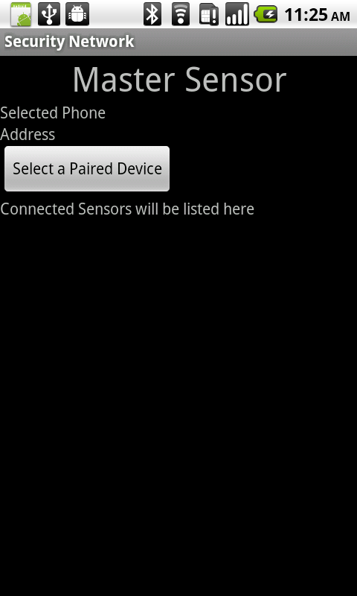
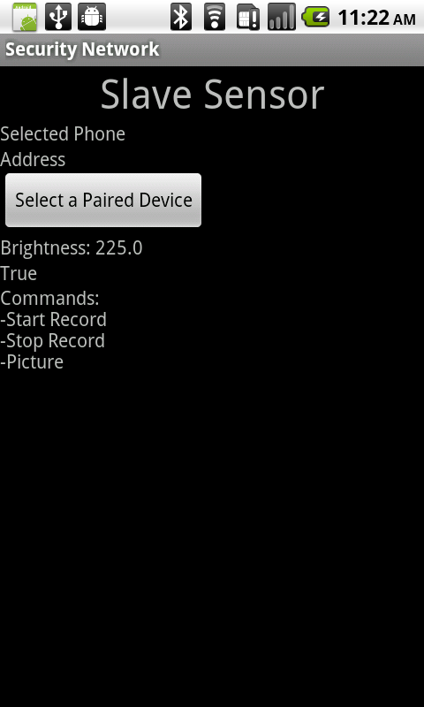
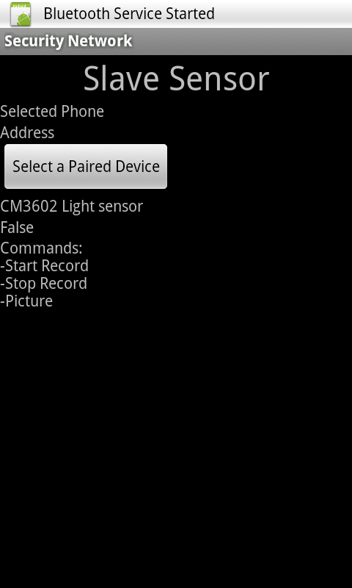

Sensor networks on a mobile platform
Ryan Donnelly, Paul Baskett, Tiancheng Zhaung
University of Missouri-Columbia
Screenshots
Introduction
Smartphones have many sensors and collectively they can form a sensor network to monitor the environment. A security network was created with three to four smartphones, where the smartphones react to their sensors and collect data. The data can track things like who entered a room and what that person is doing. When the light sensor receives light, the program takes a picture and records audio. One major problem is that the light sensor is inconsistent. All of the data collected from each sensor is returned to one central smartphone. This data, picture and audio files, can then be interpreted. This ad-hoc type of security network could be very helpful if you need to set up quickly.
Methods
The application was developed for Android devices using Eclipse integrated development environment. Devices communicate with each other using Bluetooth file transfer protocol. The master sensor can connect to many slave sensors at a time, up to seven currently. The application must be started when in a lit area, because this first value is used to compare what is light and what is dark for the light sensor. Whenever this initial value or higher is obtained from the light sensor, the slave sensor will take a picture and start recording audio. Every ten seconds, the application will check to see if there is still light being received. If there is light being received, audio will continue to be recorded, and another picture will be taken. Whenever the light sensor stops receiving light, the audio will stop being recorded and if a master sensor is connected via Bluetooth, the data will be sent back to it. A message will also pop up on the slave sensor with the filename and path of the recorded audio. The pictures will be sent to the master sensor also, and will be stored in the same directory.
S
S
M
S
S
Problems
Future Work
Acknowledgement
Results
Light sensor is very inconsistent
Still has bugs
Unclean code structure
Making the light sensor more reliable
Making the interface look better
Adding video capture to the slave sensors
Fix all bugs
Clean up code structure
This undergraduate research project has been funded by the National Science Foundation.
The results showed that the light sensor is extremely finicky and does not work consistently. Sitting completely still in one light source, the light sensor brightness will fluctuate. When the application gathers the audio and picture data, sometimes it will fail to capture more pictures. Beyond this, there are still bugs in the code and it is far from perfect.
Ryan Donnelly
Undergraduate Student: Computer Science
rjdgy5@mail.missouri.edu
Student Mentor: Paul Baskett
Graduate Student: Computer Science
pkbkbc@mail.missouri.edu
Student Mentor: Tiancheng Zhaung
Graduate Student: Computer Science
tz9q3@mail.missouri.edu
Faculty Mentor: Dale Musser
Professor: Information Technology
musserda@missouri.edu

