Slide 1
PhotoShare Application
Phillip Hanna
Jordan Hull

Slide 2
Abstract
The purpose of this project was to allow users to share images over an ad-hoc network. Android phones currently do not have API support for ad- hoc communication between phones. In this project, rooted Android phones and installed drivers were used that allow users to set up Wi-Fi communication between phones and transfer images. With this Wi-Fi capability, the average user could set up an ad-hoc network and share data with other Android phones using an application downloaded from the Android Market.

Slide 3
Transfer Rate KB/s

Slide 4
Test Results
Minimum rate – 198
Maximum rate – 321
Average transfer rate – 264 KB/s
New testing (~1 MB/s)

Slide 5
Future Work
Implementing multi-hop
Image compression
Automatic IP settings
Security
Sending/Receiving files at the same time
General stability issues

Slide 6
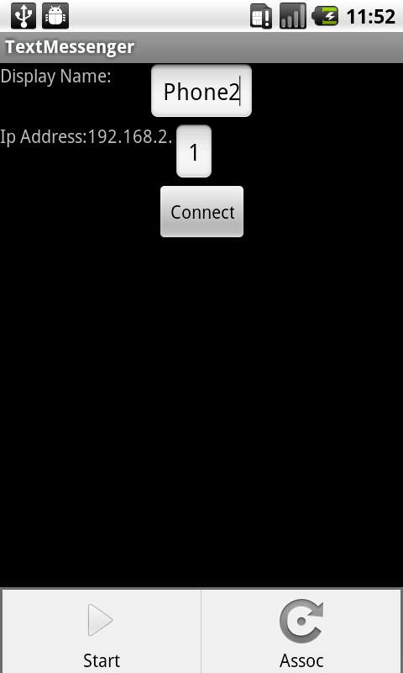
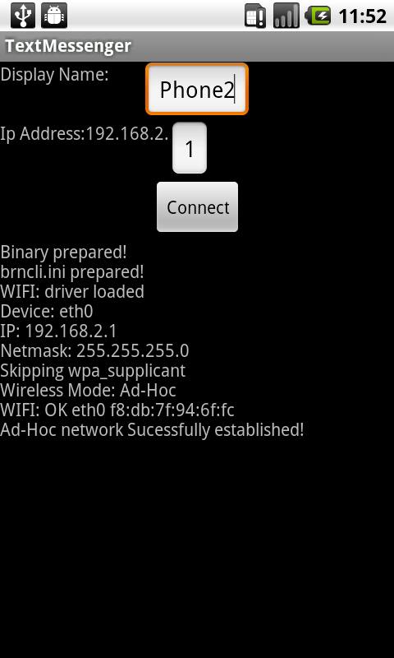
Connection Screen

Slide 7

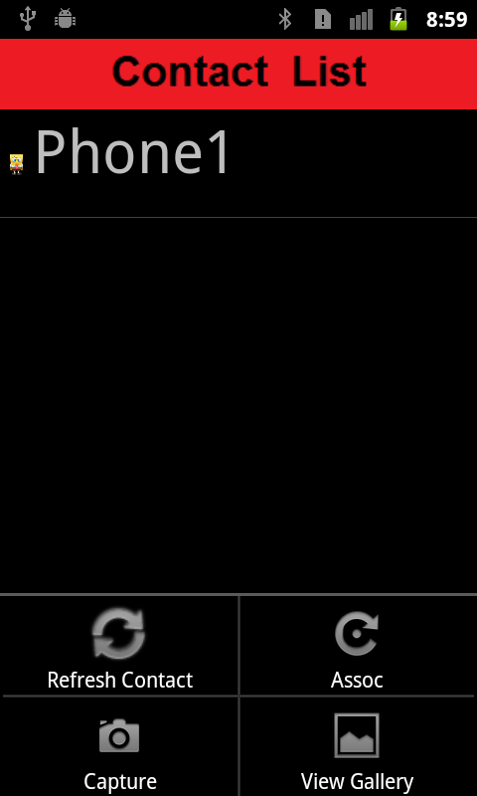
Contact Screen

Slide 8

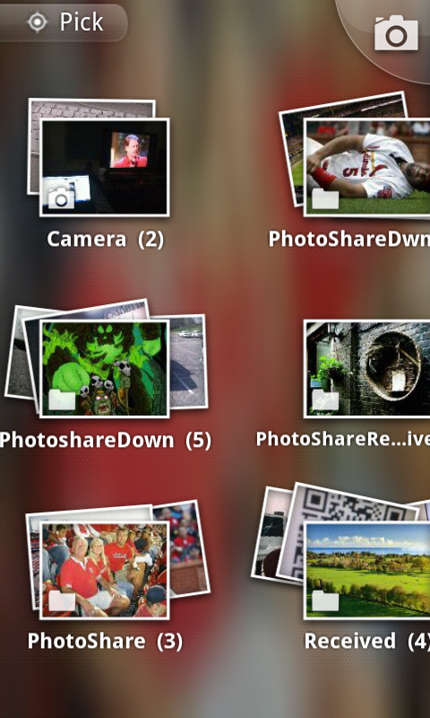
Sending Screens

Slide 9
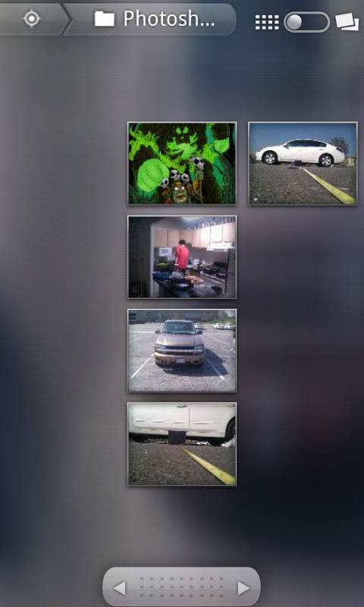
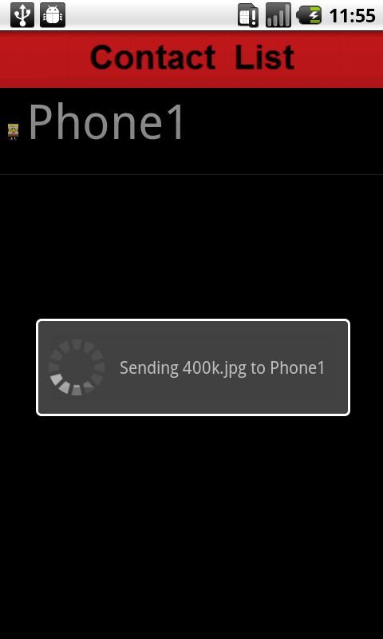
Sending Screens

Slide 10
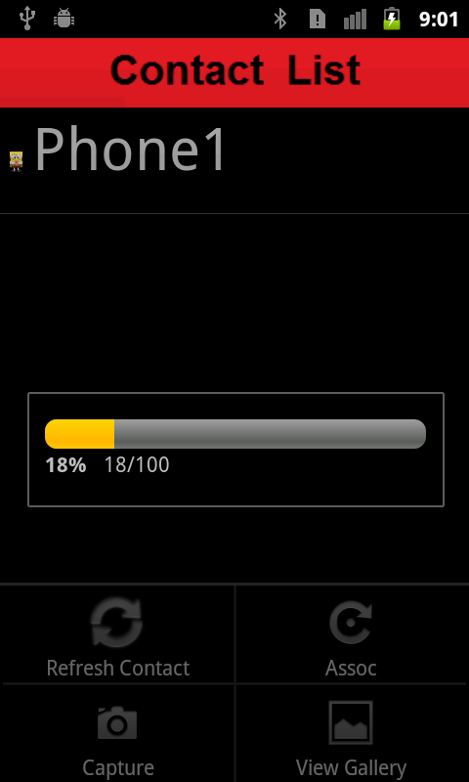
Receiving Screen

