Slide 1


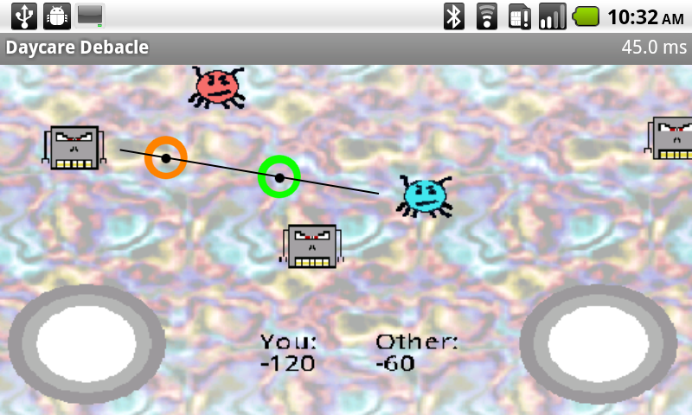
Using Bluetooth on Android Devices to Implement Real-Time Multiplayer Games
Brad Boone, Corey Darr, Chris Hayes, Dale Musser, Ph.D.
Introduction
With the rise of Android as a popular and open-source mobile operating system, development of real-time video games is on the rise. The portability of Android devices (especially smartphones) lends itself to multiplayer gaming; however, without rooting a device, developers are limited to using the Bluetooth wireless protocol for ad-hoc networking. Our work focuses on two-player, real-time, ad-hoc-networked gaming over Bluetooth, primarily on two HTC Nexus One smartphones. We set out to show the feasibility of such games, and to explore the issues of division of processing, latency, and network infrastructure.
Overview
Bluetooth
Mobile devices often include Bluetooth radios to communicate with peripherals (i.e. Hands-free devices, headphones, etc.). By utilizing this feature, Android devices can communicate with each other wirelessly.
Mobile gaming
Evidenced by hundreds of games available for download through the Android market, users enjoy breaks from everyday life via video games. By combining the Bluetooth capabilities of Android devices, users can partake in games involving those around them.
Problems
Real-time multiplayer games require fast connections to perform properly. Players constantly send messages to each other through their devices describing each player’s current game state. One missed or late message could potentially destroy the illusion created by the game. Real-time games must include compensation for these messages to ensure both players experience the same gameplay.
Solutions
Lost and late messages are inevitable in an imperfect environment. To resolve issues created by these occurrences, each device follows a specific set of rules which define how they behave during gameplay. For instance, certain messages require acknowledgement on receipt. If a receipt is not detected, the message is resent, assuring that no message is truly lost. Late messages also follow a specific set of rules. Before time critical events are sent, the time required to send a message is calculated, and then the message is changed to predict what will happen within that time period before it is sent.
Future Work
Currently, games are limited to two players. Adding players greatly increases the chance for late and lost messages and complicates the process of compensating for such events. Other considerations also include extending the range of the Bluetooth radios using a multi-hop networking process. This would require each device to pass along messages in chains and introduces interesting new problems.
Conclusion
Since nearly all multiplayer games involve shared resources and entities, a client-server model proves essential, providing unity and structure. Although Bluetooth features significantly less bandwidth than Wi-Fi, it can work for games, given that the developers effectively utilize event-based messaging, allowing the client to process the game locally given the most recent information. Additionally, a data protocol such as JavaScript Object Notation helps send messages that are both easy to parse and low in overhead, helping to keep latency to a minimum. Programmers would also do well to implement a custom network infrastructure, using layers to separate data transfer from gameplay and prevent coupling of classes.
Inner Workings
Player 1
At the world level, each device handles the drawing of the playing field.
At the game level, each device is responsible for timekeeping, advancing game objects, and receiving events, both local and those created by the other device.
At the network level, message handling, creating takes place. The interface also controls the inner workings of the Bluetooth radio.
At the bluetooth level, messages are sent and receive and passed along to the network interface.
Player 2
World
World
Game
Game
Network Interface
Network Interface
Bluetooth Connection Service
Bluetooth Connection Service
Green arrows indicate messages from Player 1 to Player 2.
Orange arrows indicate messages from Player 2 to Player 1
Game screenshot demonstrating the effects of a uncompensated, late message. The green circle indicates where the bullet appears to be, and the orange circle indicates where it actually is. The bullet’s path is also drawn.

